Slide 1
The Whole World in our Hands
KS1 [30 mins]
Notes:
Welcome!
This lesson is called The Whole World in our Hands - does anyone know a song which has those words in it?
Option to sing the song together.

Slide 2
Notes:
1. Introducing Natural materials and Human-made objects [5mins]
a) Teacher clarifies the difference between natural materials, which come from the Earth, and human-made objects, which are produced from natural resources for us to use.

Slide 3
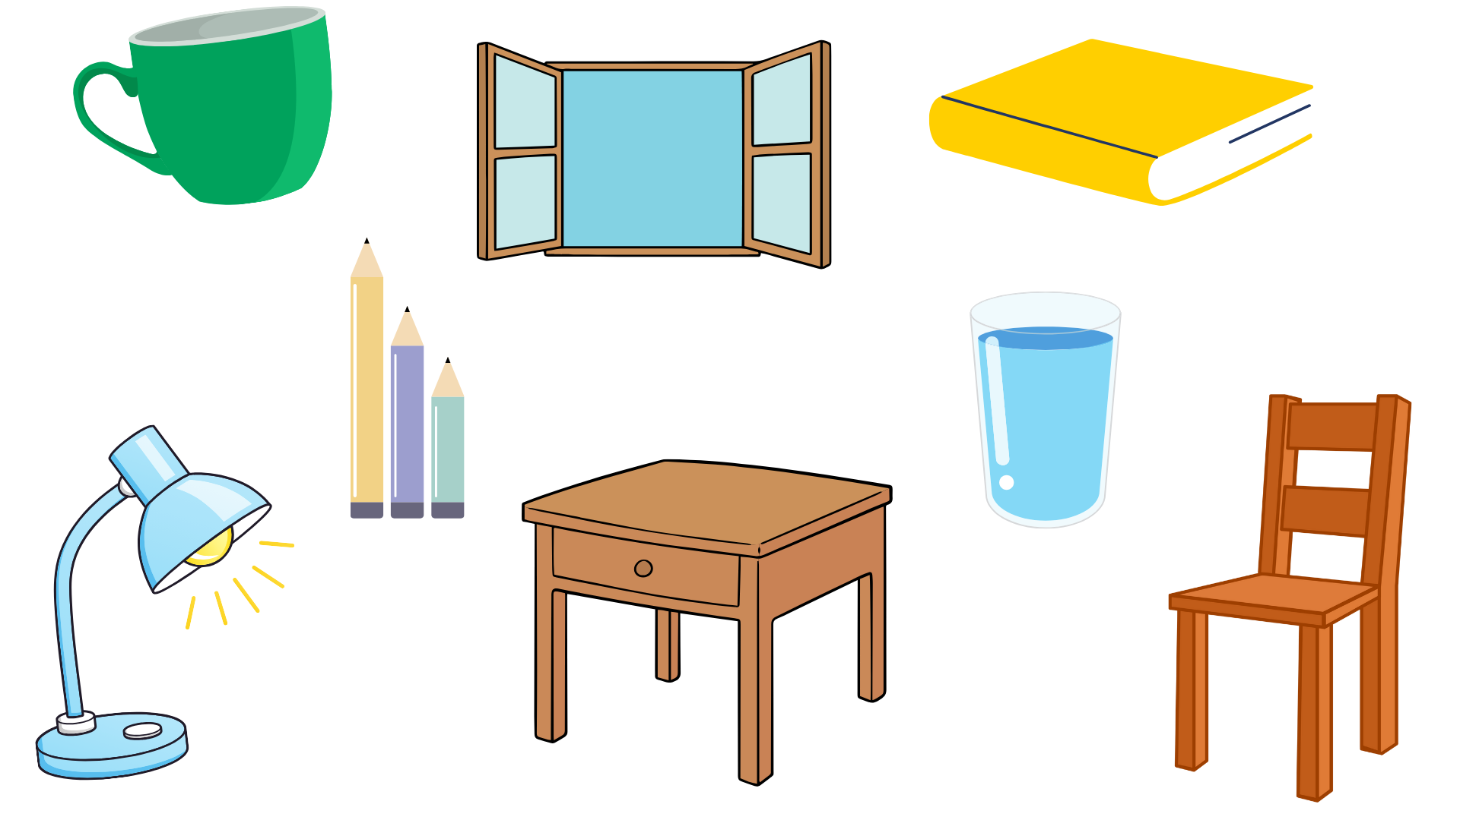
Notes:
b) “We are going to use the items in our classroom to record the difference between human made objects…”

Slide 4
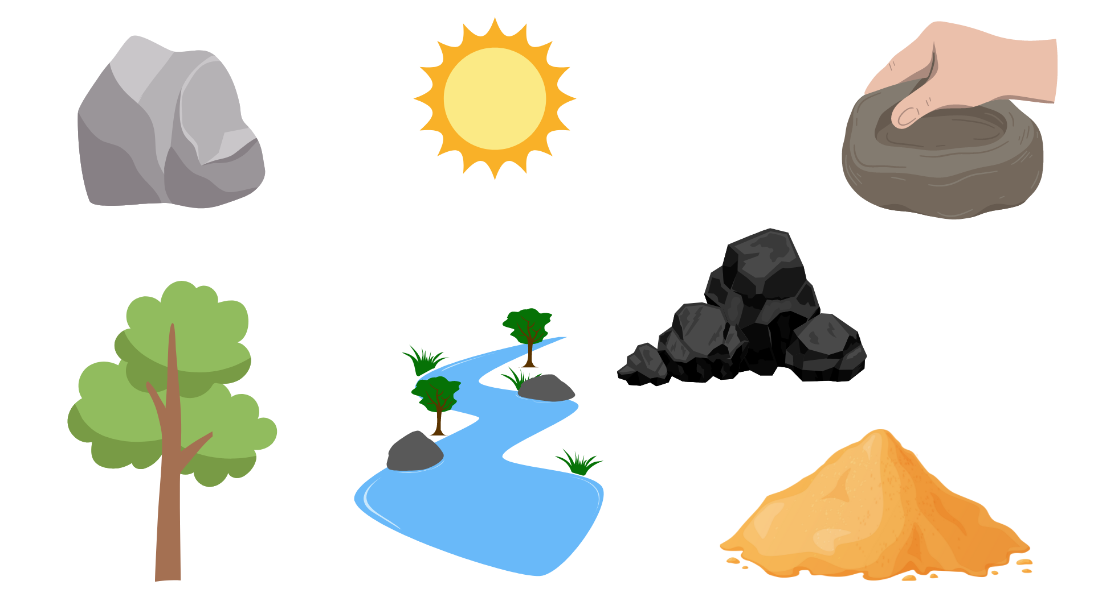
Notes:
…and natural materials”

Slide 5
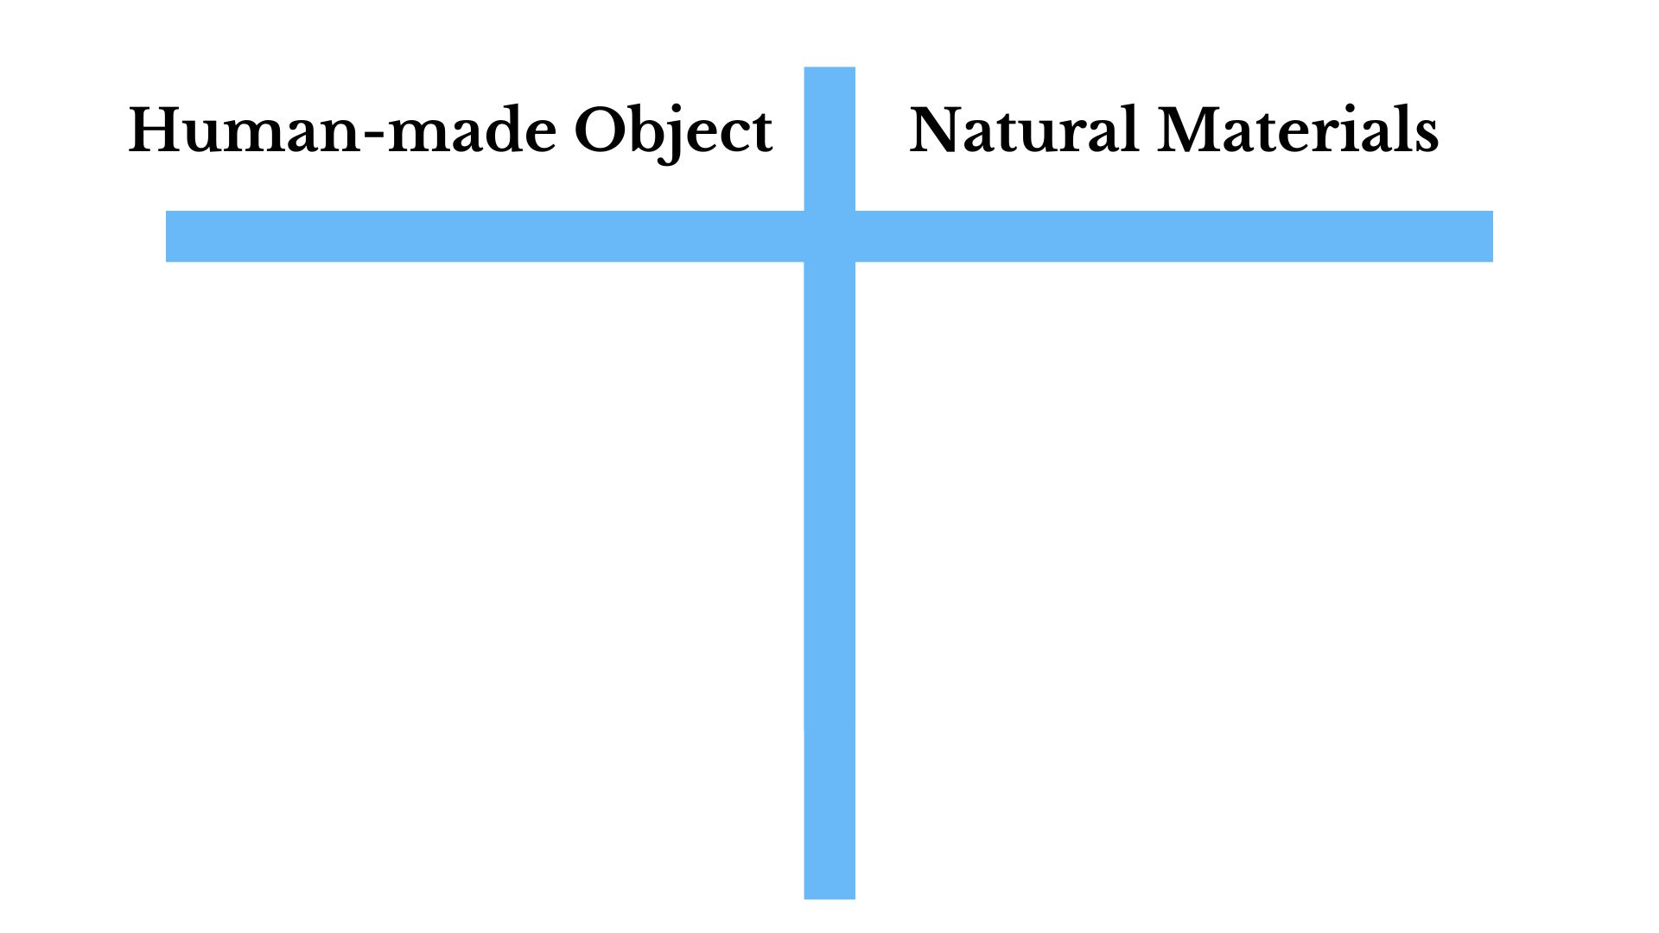
Notes:
2. Natural materials and human-made objects in the classroom [10 mins]
a) Each pupil will create two columns (Natural Materials, Human-made Object) on paper + clipboard with a ruler.
NB: As indicated in the National Curriculum, the key focus here should be on the difference between an object, which has been produced by humans, and a natural material, which has been produced by the Earth.

Slide 6
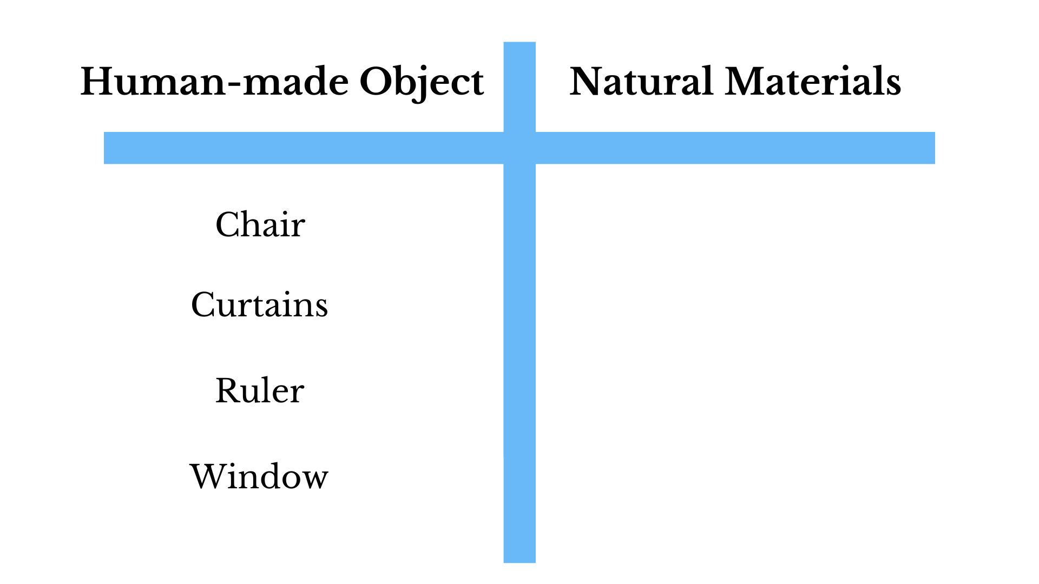
Notes:
2. Natural materials and human-made objects in the classroom [10 mins]
b) Children work in pairs to identify classroom objects. “Look at objects you can see around you and write them down in the objects column.”
NB Option to travel around the classroom during this activity.

Slide 7
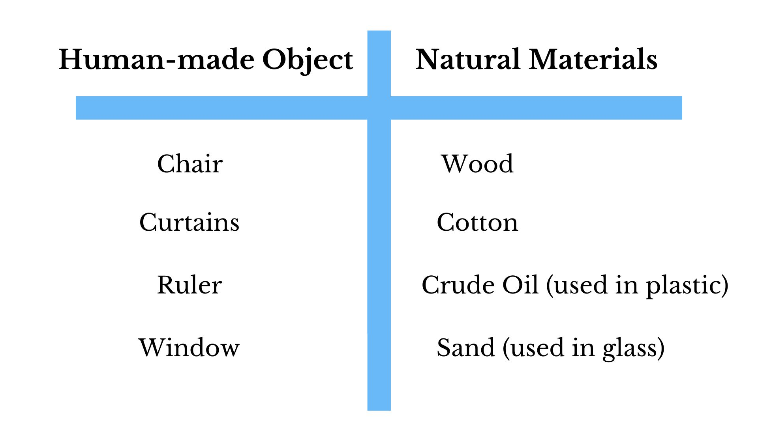
Notes:
2. Natural materials and human-made objects in the classroom [10 mins]
c) Teacher reminds the difference between objects and and the natural material they have been made from.
d) Teacher models this activity by selecting a few items from the classroom and highlighting the difference between objects and the materials which the objects are made from.
e) Children try to work out which natural material the objects are made from and write them down in the ‘natural materials’ column
Teacher may need to support with some objects:
E.g. Glass is made from sand, plastic objects are made from (crude) oil, pencil ‘lead’ is from graphite, a type of rock, mug from clay etc

Slide 8
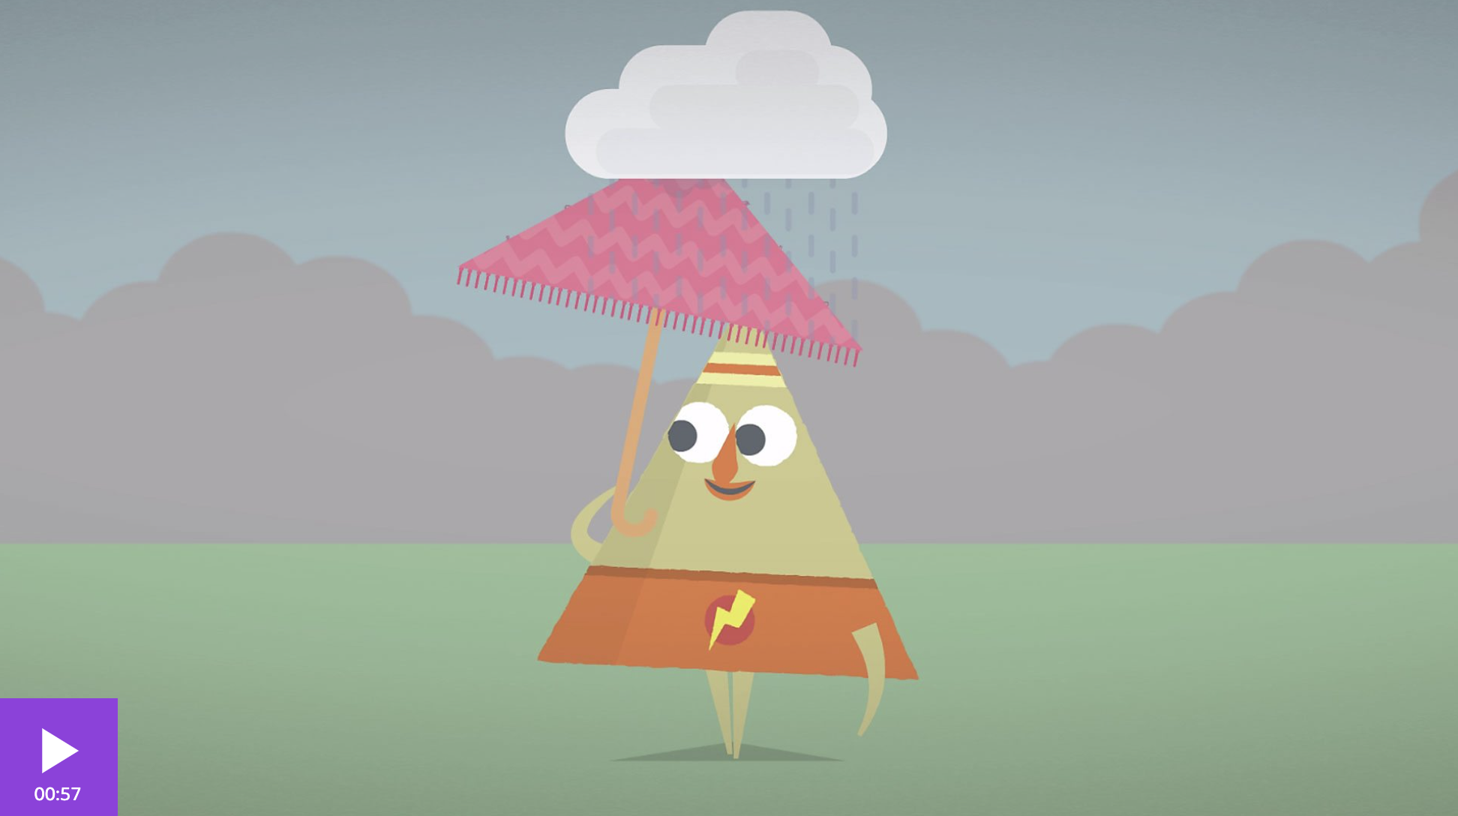
Notes:
3. Properties of different objects: [5 mins]
WHY are different objects made from different natural materials? Let’s find out…
a) Watch this 1 minute video about the properties of different materials.
https://www.bbc.co.uk/bitesize/articles/zx8hhv4

Slide 9
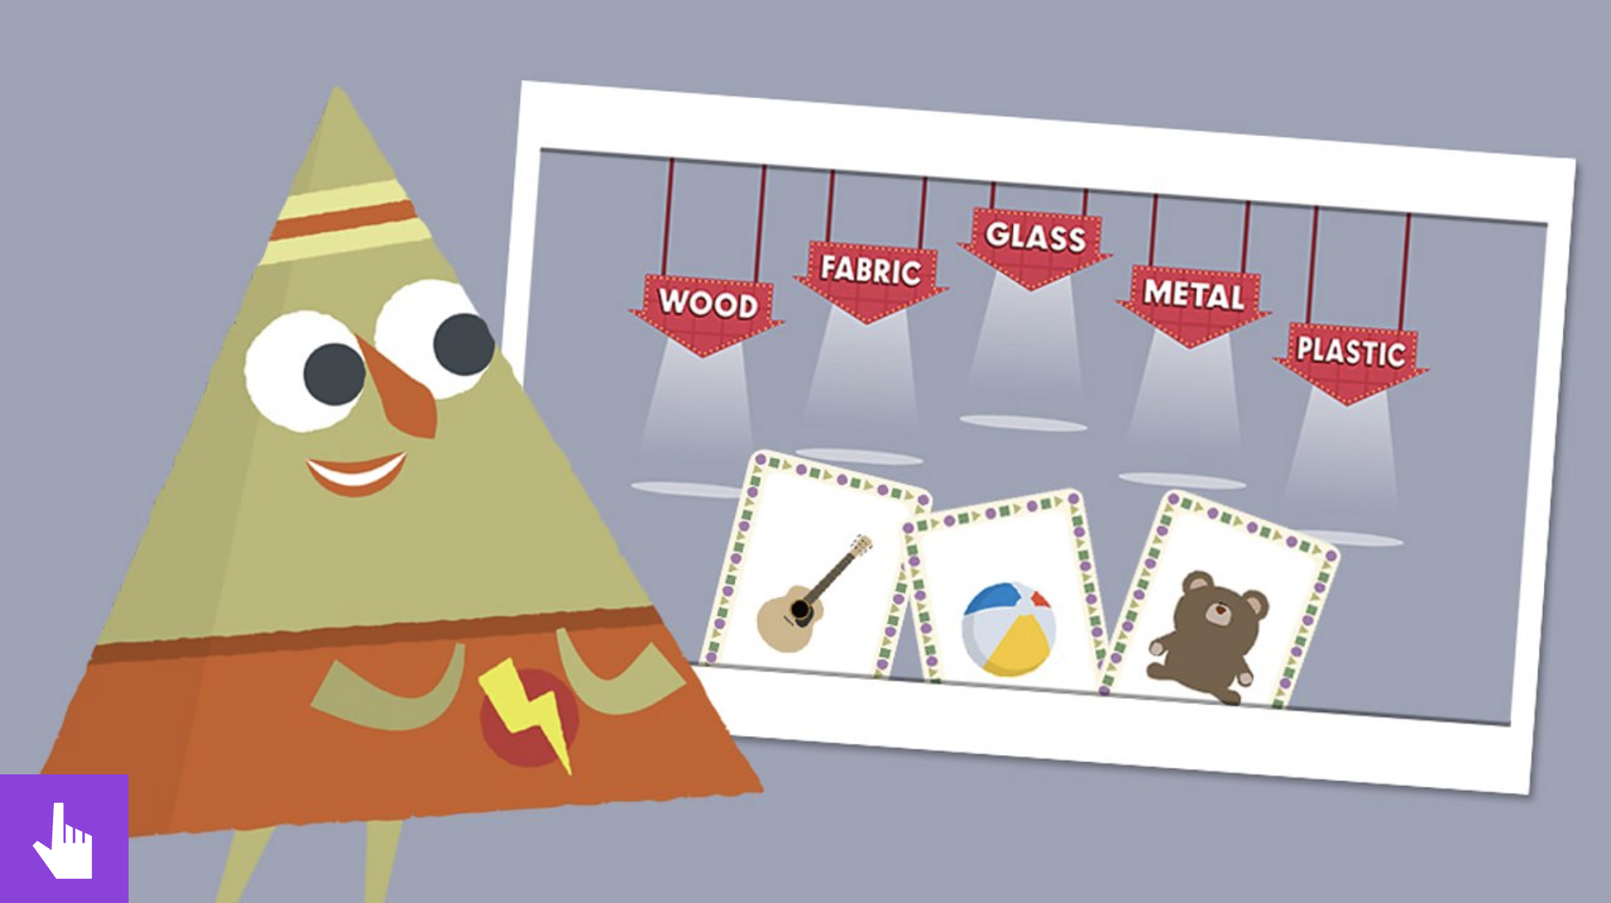
Notes:
b) Teachers lead a group response to the sorting activity below the video.

Slide 10
Notes:
c) Returning to classroom objects, teacher asks for suggestions about why particular materials have been chosen for particular objects.
E.g. wood can be moulded into all different shapes for our furniture, glass is waterproof to protect us from rain

Slide 11
Notes:
5. Lesson Ending: Living sustainably [5 mins]
a) Teacher reminds children of the previous lesson’s key learning of ‘just right’ and how using too many
natural resources such as trees and oil can disrupt the Earth’s natural balance.

Slide 12
Notes:
5. Lesson Ending: Living sustainably [5 mins]
b) Teacher encourages children to suggest ideas for how to keep this balance by using fewer resources.

