Slide 1
Taking a Leaf out of Nature’s book
KS2 [50 mins]
Notes:
Welcome!
This lesson is called Taking a leaf out of Nature’s book.
Does anyone know the connection between trees and books?

Slide 2
Notes:
1. Explain the task: [10 mins]
a) Teacher clarifies Key Fact that most paper comes from trees, so in this lesson we are going to make mini leaf books and learn something from the leaves.
b) Discuss why leaves might fall from a tree - imagine they are trying to tell us a message, like when a leaflet comes through the door.
c) (On next slide) Watch film of leaves falling and reflect on what might be the messages trees want to spread?
(E.g. that trees are good for us and the planet).
OPTIONAL: Go out to the outdoor space and watch the leaves falling from a tree. Choose leaf.

Slide 3
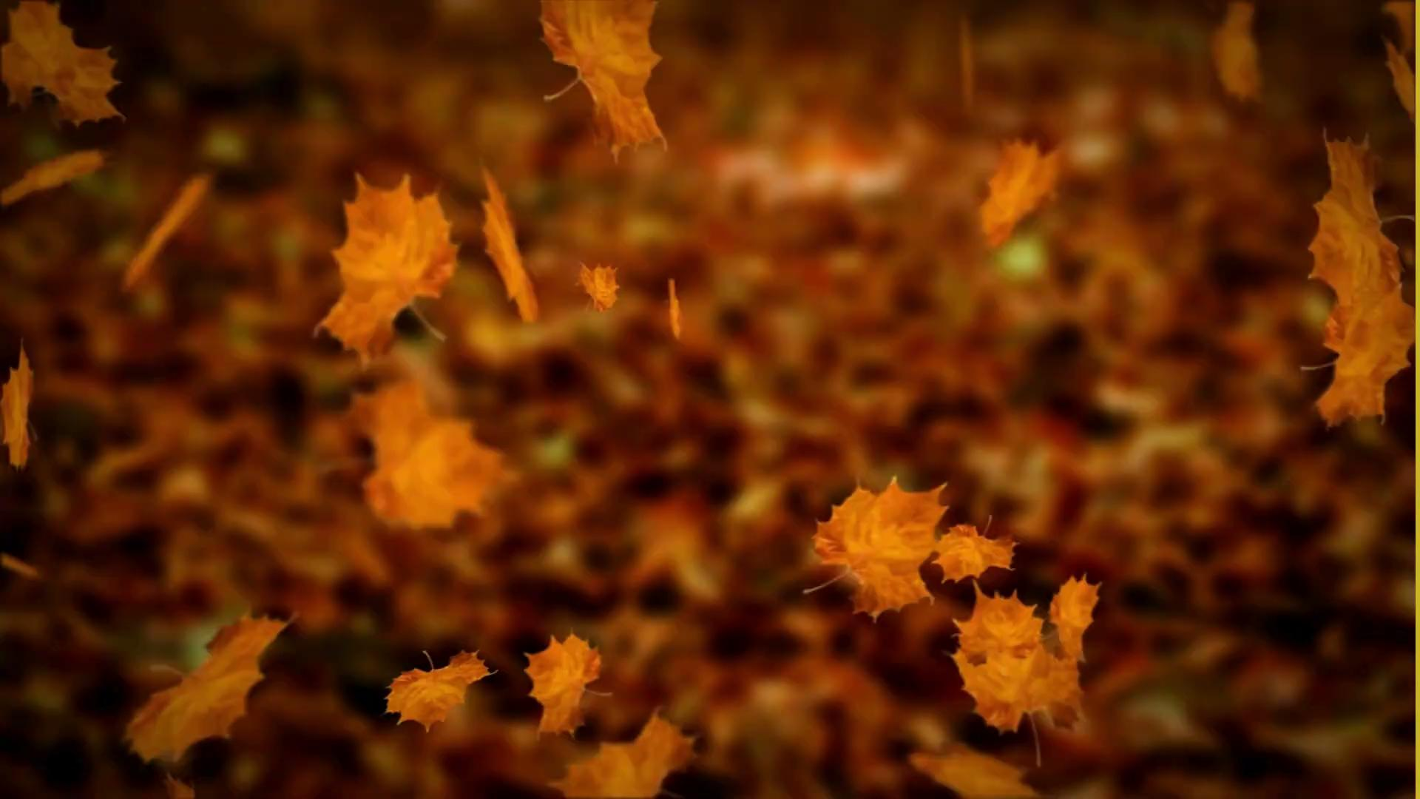
Notes:
The next activity explains why trees are good for us and the planet.

Slide 4
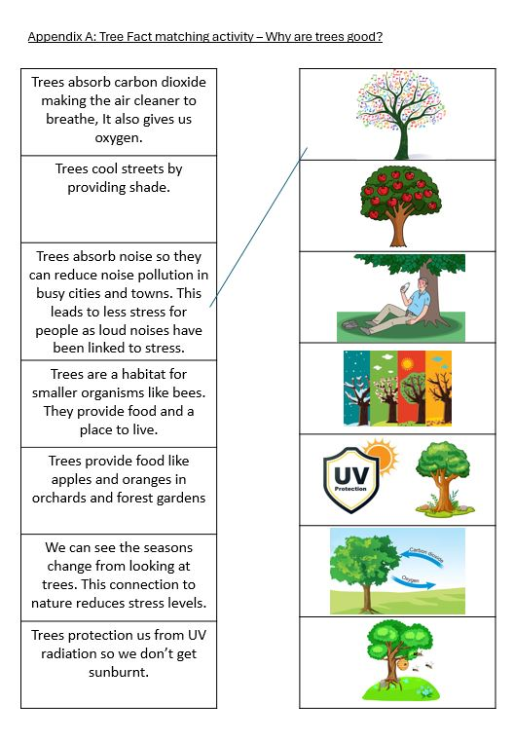
Notes:
2. Pair Activity: Why are trees good for us? [10 mins]
a) Pupils given print out of tree facts to be matched with correct images (see appendix A and B) using
which they choose some facts to read aloud to their partner.
b) With your partner, can you think of things you have in common with
trees? Teachers leads group sharing of these.
Things we have in common with leaves:
Breathing, growing, needing water, sunlight and food, returning to the Earth

Slide 5
Notes:
3. Choosing and writing leaf messages [15 minutes]
a) Drawing upon tree facts, pupils create a short message for their leaf which shows why trees are
beneficial OR how we humans are similar to trees.
b) Teacher demonstrates how to use watercolour pencils (see guidance on session plan).
c) Pupils write messages on leaves. Teacher assists by role modelling, and sharing examples which
pupils create (See Appendix C for examples).

Slide 6
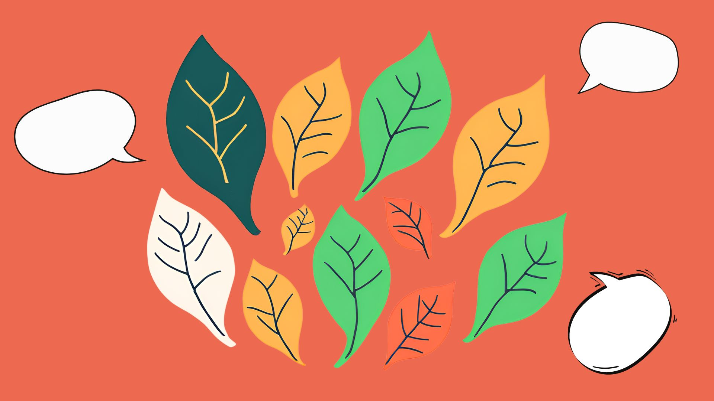
Notes:
4. Paired performances of leaf poems: [10 mins]
a) Children walk around the classroom with their leaves.
b) Meet another child and put their two leaves together into a ‘leafbook’
c) Read aloud two leaves together to create a ‘poem’.

Slide 7
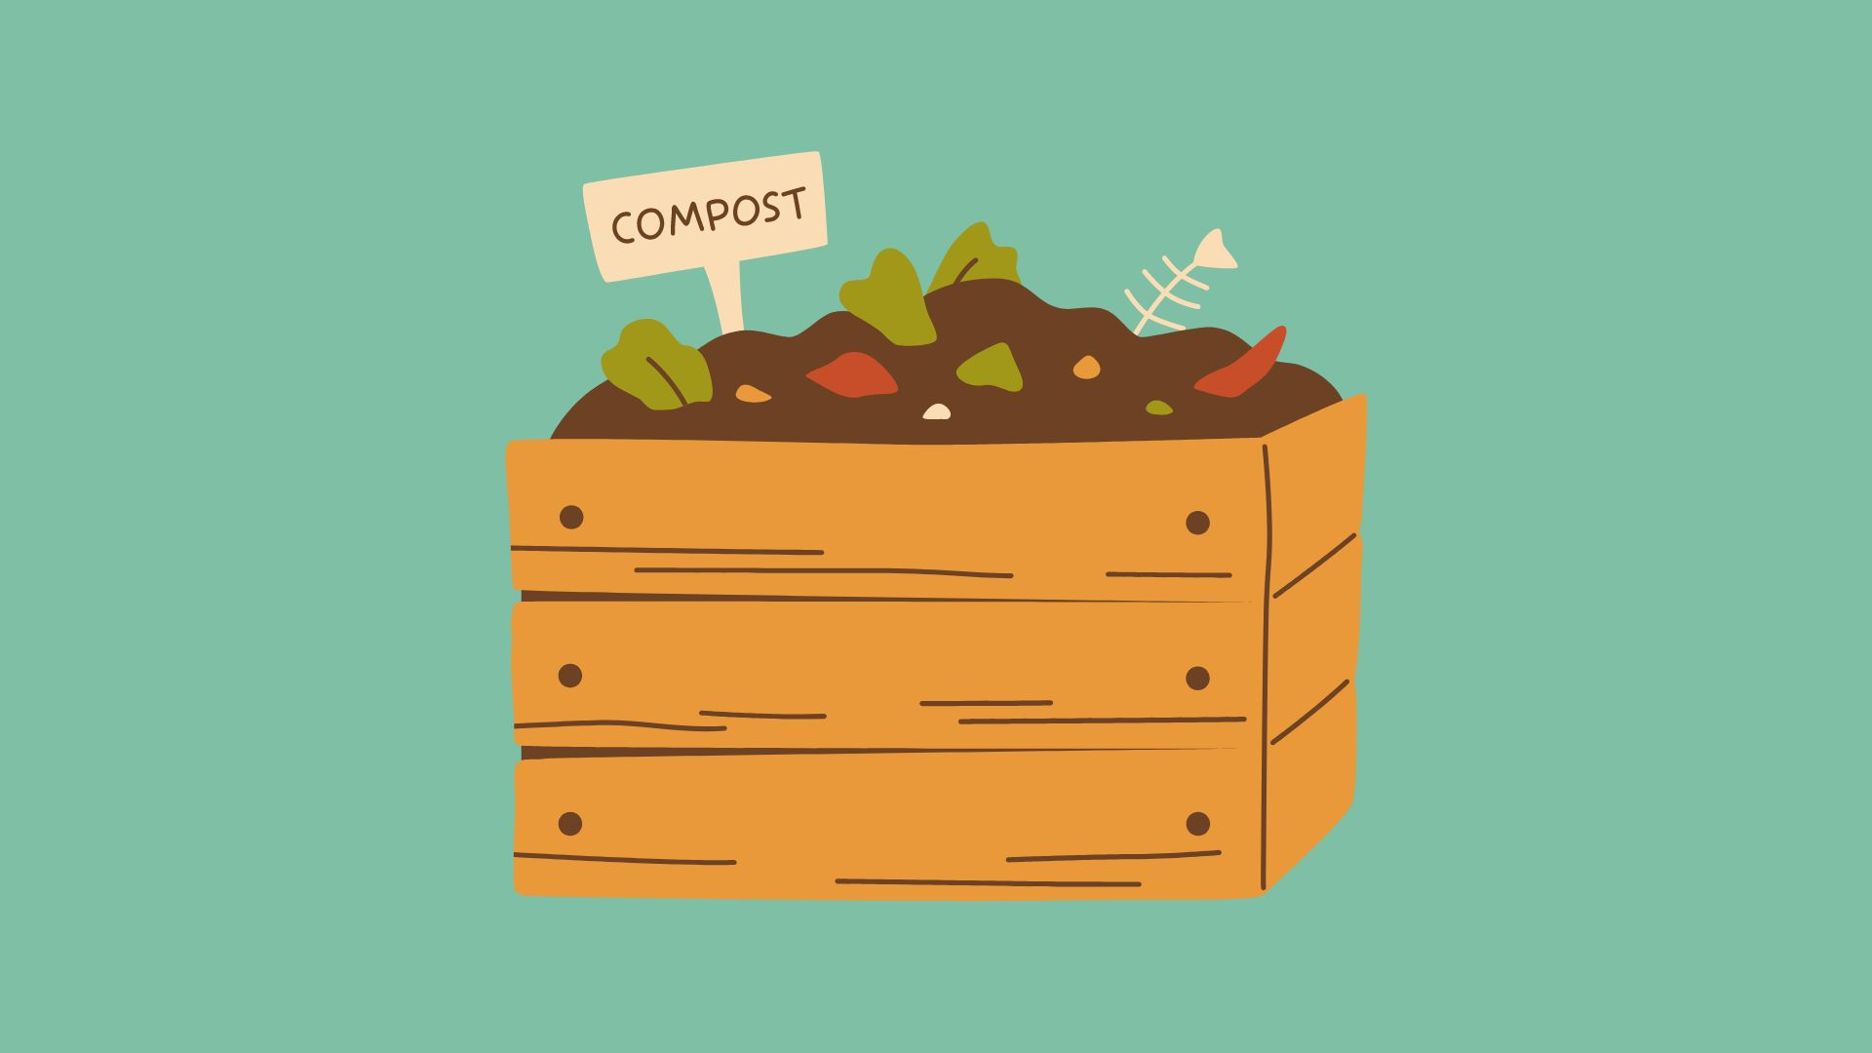
Notes:
5. Lesson Ending: Composting messages [5 mins]
a) Teacher explains that they will return the leaves to the Earth, providing nutrients for other plants
to grow in a process known as composting. This is why we are using water soluble crayons.

