Slide 1
Protect the Lowland Heath
KS2 [50 mins]
Notes:
Welcome!
This lesson is called Protect the Lowland Heath - does anyone know what a heath is? And What does lowland mean? Let’s find out…

Slide 2
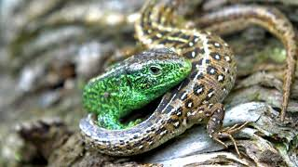
Notes:
1. Watch the “Wildlife in the Lowlands Heath” video from 00 - 00:50: [5 mins]
a) Clarify with pupils what ‘habitat’ means and what it means to say that lowland heath is “One of the rarest habitats on earth”?
b) Who can think of other examples of habitats? (rainforests, woodland, grassland, ocean, seashore, parks, buildings?)

Slide 3
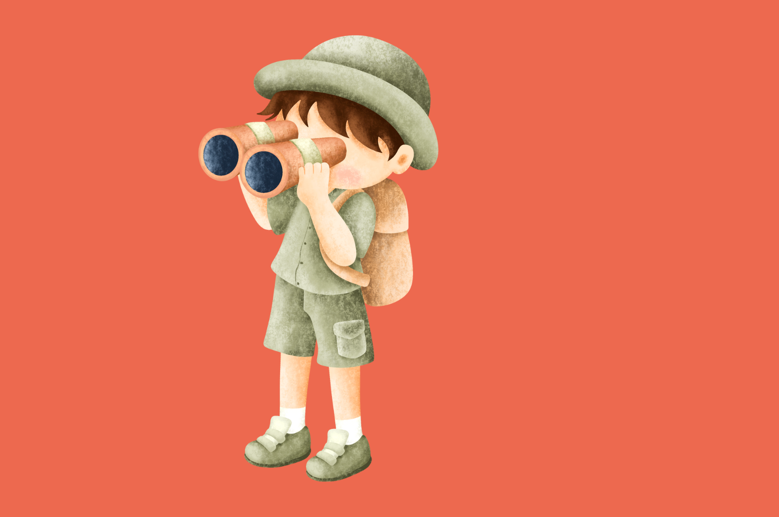
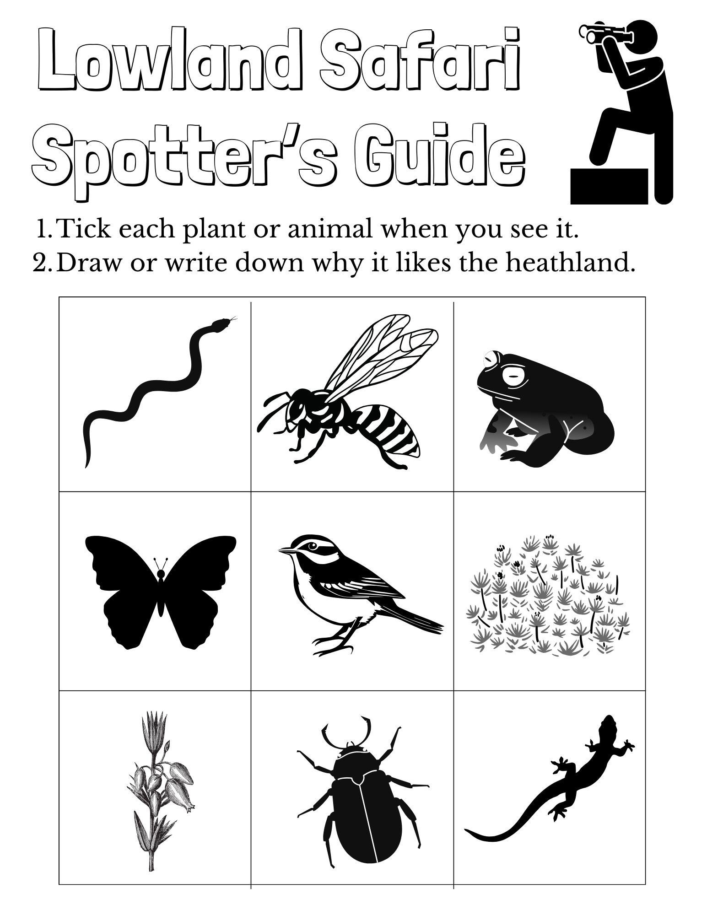
Notes:
2. Play the ‘Lowland Safari’ game using the Spotter’s Guide (Appendix A - print off for pupils) [10 mins]
a) Continue watching the video from 00:50- 8:56
b) See how many different types of plants or animals you can spot.

Slide 4
Notes:
2. Play the ‘Lowland Safari’ game using the Spotter’s Guide (Appendix A) [10 mins]
a) Continue watching the video from 00:50- 8:56
b) See how many different types of plants or animals you can spot.

Slide 5
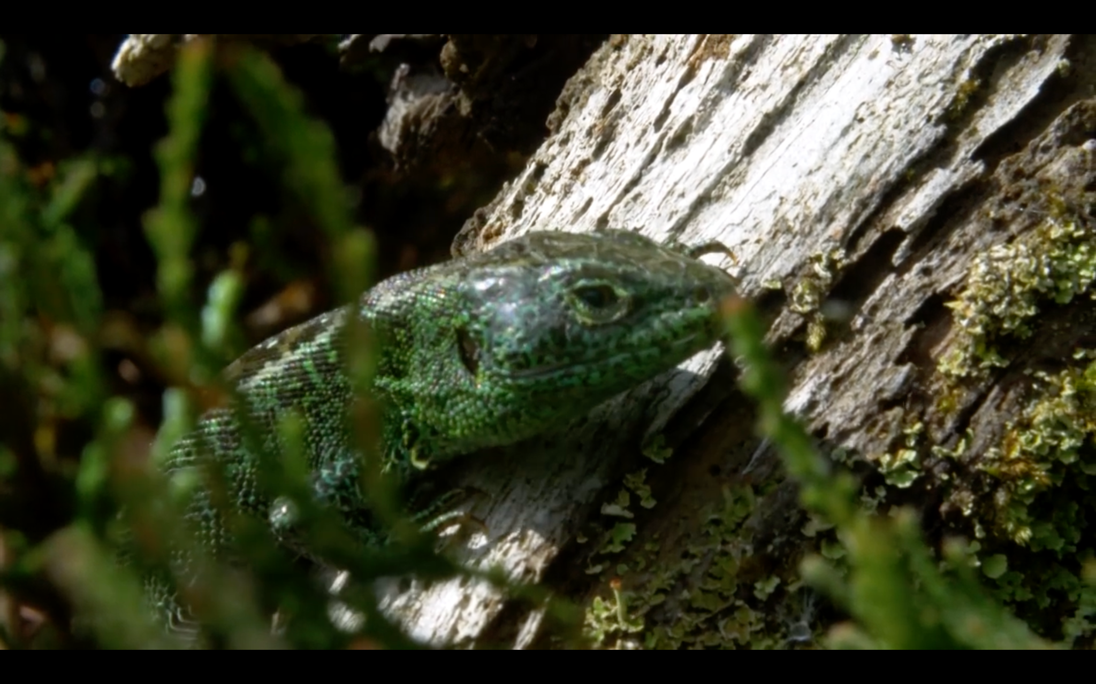
Notes:
3. Group discussion on Heathland as Habitat: Why is the heathland a good
habitat for these plants and animals? What does it provide? [5 mins]
Answers:
What does the Heathland provide?
Burrows for Sand Lizards
Bugs to eat for Dartford Warblers
Water for Dragonflies to lay eggs,
Heather for Silver Studded Blue Butterfly’s eggs
Mating place for Field Crickets and Natterjack Toads.
Boggy soil for Common Haircap Moss (draw out what plants and fungi need as well as animals)

Slide 6
Notes:
4. Loss of habitats: Continue watching the video from 08:56 - 10:30 [10 mins]
a) Teacher clarifies Key fact: “95% of Lowland Heathland has been lost worldwide and 20% of what is left is in the UK”.
b) Ask children to guess why the lowland heath is being lost
Why is Healthland being lost?
Towns and roads
Pollution and arson
Mining and farming
Poor management
Lack of understanding of biodiversity
c) Group Discussion: Given what the healthland provides, what will happen to these plants and animals if we don’t protect the remaining Lowland Heath? e.g. Where will Field Crickets meet for mating etc?

Slide 7
Notes:
5. Design a poster to explain why lowland health is important and why we
should protect it. [15 mins]
a) Teacher gives pupils Appendix B with key facts about the lowland health to support them in
making a poster which highlights the importance for biodiversity (these facts are also on the following slide).
b) During this exercise the teacher has the option to leave on the Heathland Wildlife playlist to
remind pupils of the plants and animals and use the bingo sheet as a reminder.

Slide 8
Key facts about the lowland heath
a) 95% of Lowland Heathland has been lost worldwide and 20% of what
is left is in the UK.
b) In the UK we have only about 16% left of the area that existed in
1800. Most of this loss has taken place recently.
c) Natterjack Toad is said to be the loudest toad in Europe.
d) Dartford Warblers are only found in Lowland Heaths.
e) All six native British reptiles are found in some lowland heaths in
Britain.
f) Boggy mires and pools provide a home for a fascinating group of
plants that specialise in trapping insects to supplement their diet,
such as the sundews.
g) Most heathlands have traces of human use from thousands of years
ago (8,000 to 6,000 BC) right up to the present day. Heathlands are
ancient history!
Notes:
5. Design a poster to explain why lowland health is important and why we
should protect it. [15 mins]
a) Teacher gives pupils Appendix B with key facts about the lowland health to support them in
making a poster which highlights the importance for biodiversity.
b) During this exercise the teacher has the option to leave on the Heathland Wildlife playlist to
remind pupils of the plants and animals and use the bingo sheet as a reminder.

Slide 9
Notes:
6. Lesson ending: Share posters [5 mins]
a) Poster gallery: Half the pupils hold up their posters whilst the other half view and appreciate, then
swap. Talk to your desk partner about some posters you liked and why.

