Slide 1
Print the following slides double sided and see if the students can guess the career before finding out more about roles in the South Downs National Park

Slide 2
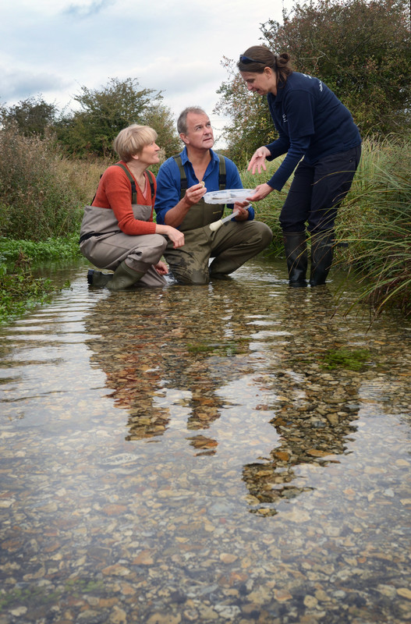

Slide 3
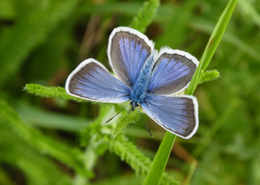
Biodiversity Officer
Subject: | Maths and Science
Skills | Understanding and interpreting data, Ecology principles, Technical understanding
Career examples | Biodiversity Officer, Climate Change Officer, Research and Evidence Officer
Biodiversity Officer
This role works with local organisations to support them to restore and protect local habitats.
On one project, an incredible 34 species of butterfly were recorded in an ecological survey, making it one of the best sites in Britain for biodiversity.

Slide 4
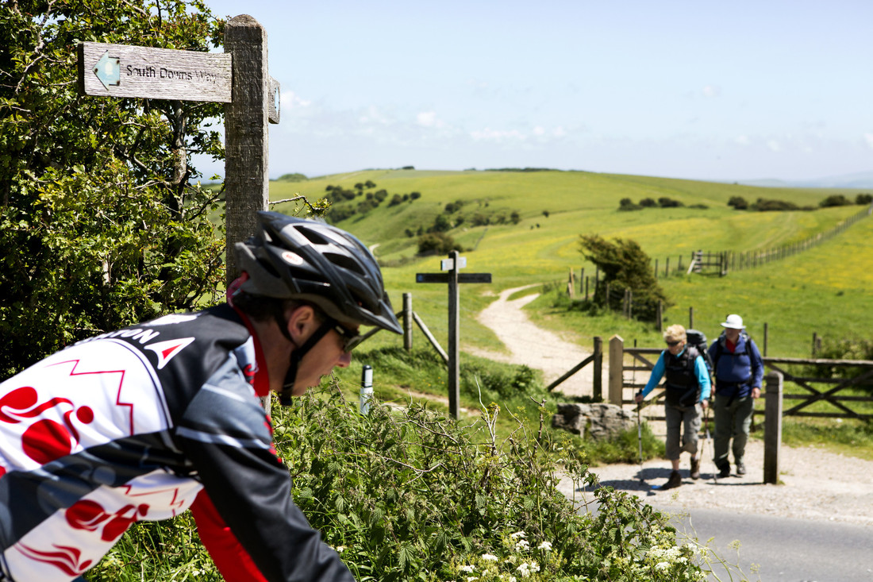

Slide 5
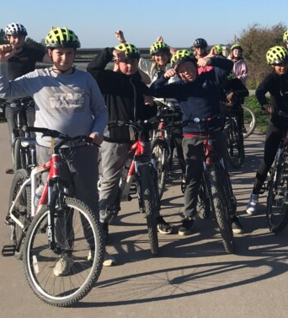
Health and Wellbeing officer
Subject: | Sports
Skills | Encouraging Active Travel Reduction of waste in sporting events
Career examples | Health and Wellbeing Officer Cycling Officer
Health and Well-being Officer
In this role, the H&WB officer can take their own love of the outdoors and share it with others. They aim to remove barriers for those that find accessing green spaces tricky.

Slide 6
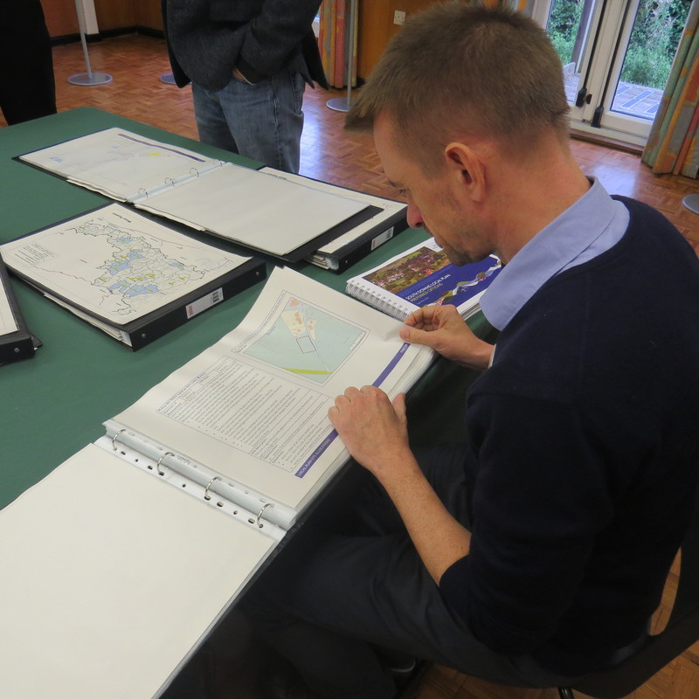
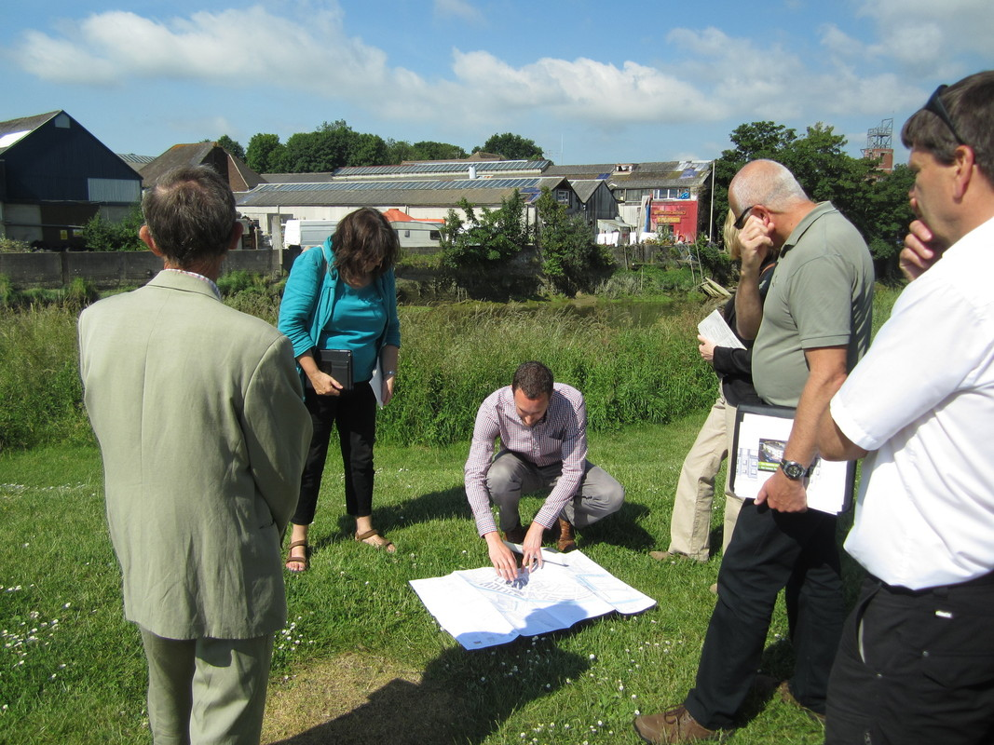

Slide 7
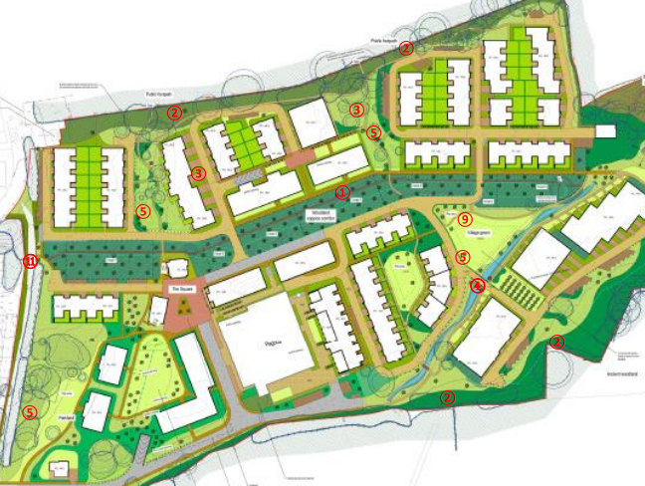
Planning Officer
Subject: | Geography
Skills | Modelling and understanding processes, Interpreting data Decision making
Career examples | Planning Officers, Landscape specialists
Planning Officers
This role supports the sustainable development of landscapes within the National Park.
Here they balanced 210 new homes being built whilst protecting ancient woodlands, restoring streams and using local building materials.

Slide 8
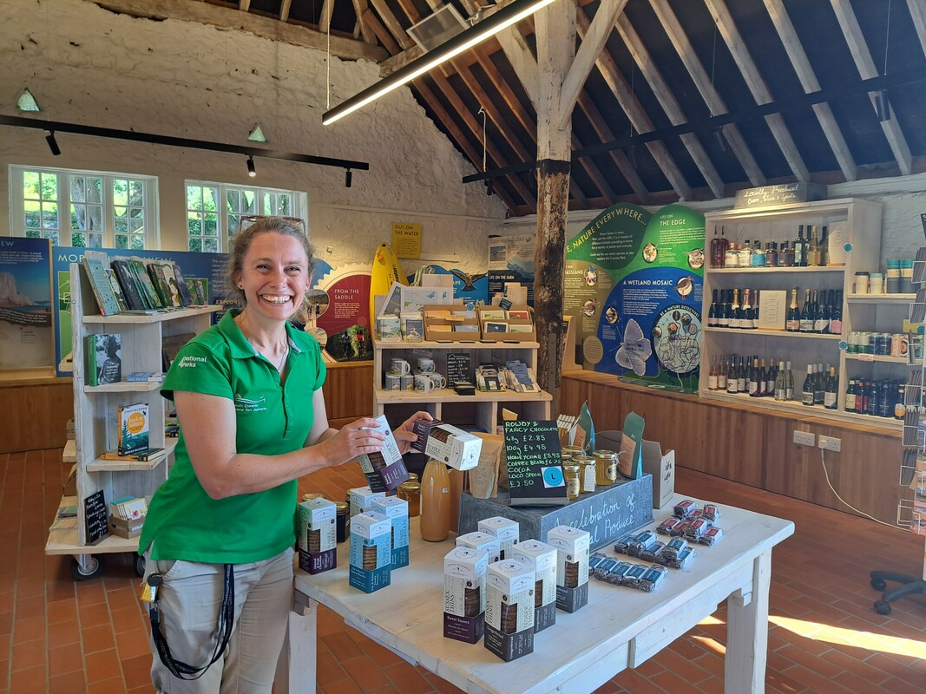
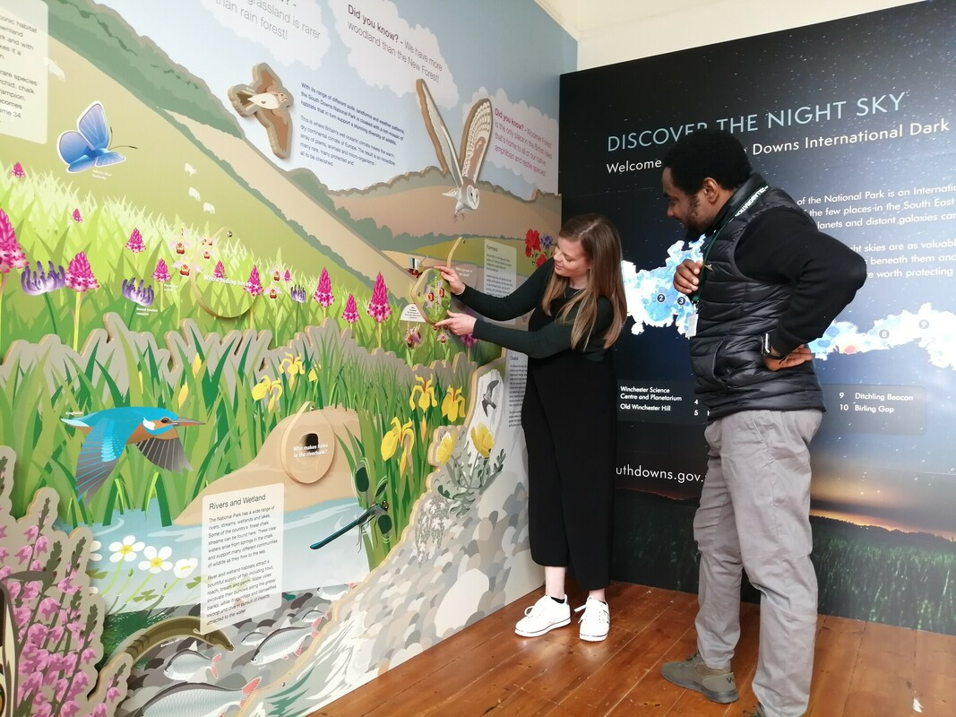

Slide 9
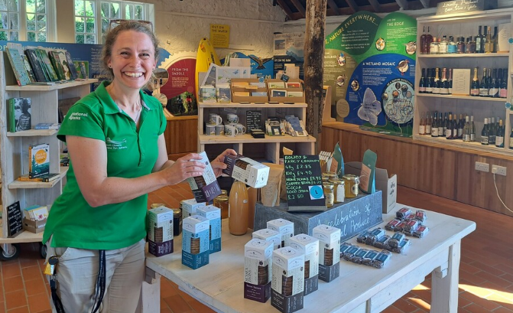
Visitor Experience Manager
Subject: | Business studies
Skills | How to be sustainable in business practise, Psychology of consumers
Career examples | Country Park Visitor Experience Manager, Sustainable Tourism Officer
Visitor Experience Manager
This role needs to balance making enough money to keep the park open whilst ensuring the human impact isn’t affecting the special qualities of the landscape.
One small step they have taken is sourcing local produce for the visitor shop.

Slide 10
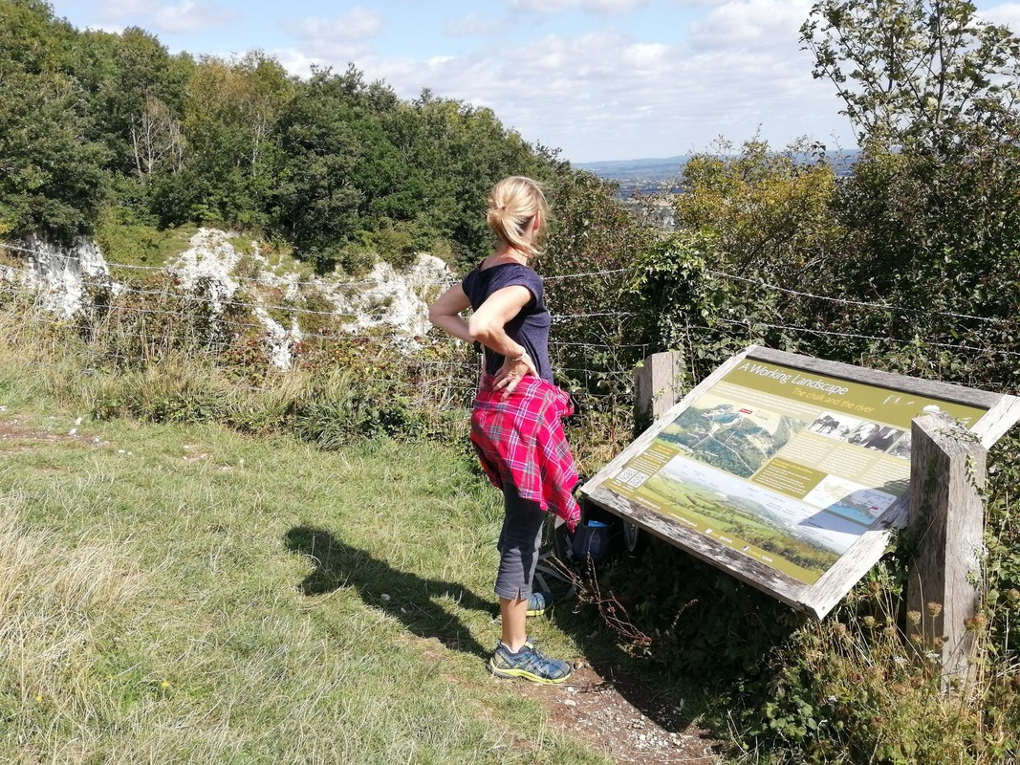
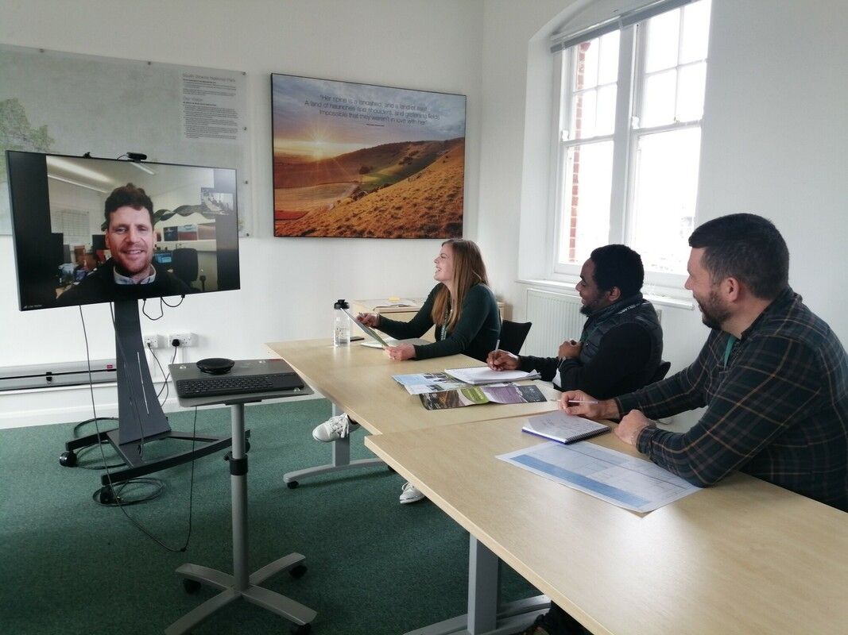

Slide 11
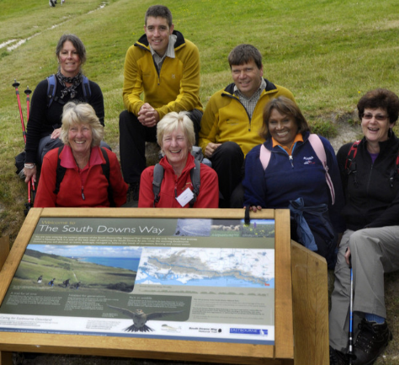
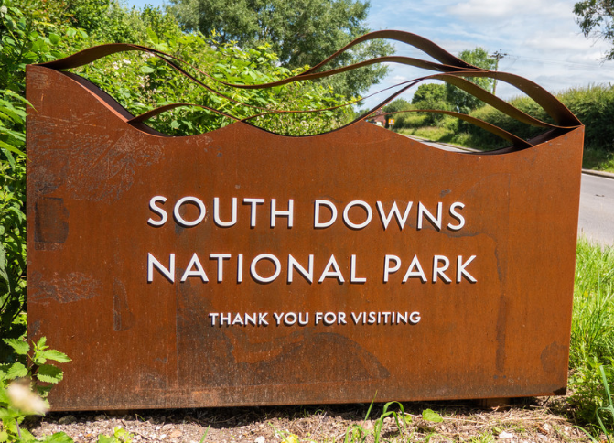
Communications officer
Subject: | Art/ English
Skills | Marketing of sustainability issues, Bringing attention to critical issues Inspiring people to make positive change.
Career examples | Communication Officer, Press Office, Interpretation Officer, Social Media Officer, Education Officer, Heritage Lead
Interpretation Officer
They design anything associate with a National Park. From the branding on this slide, to the signs you see welcoming you to the National Park, to the audio guides you can listen to around the park.

Slide 12
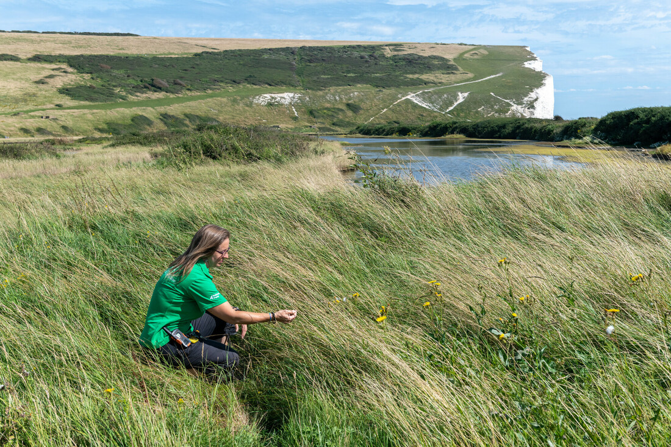
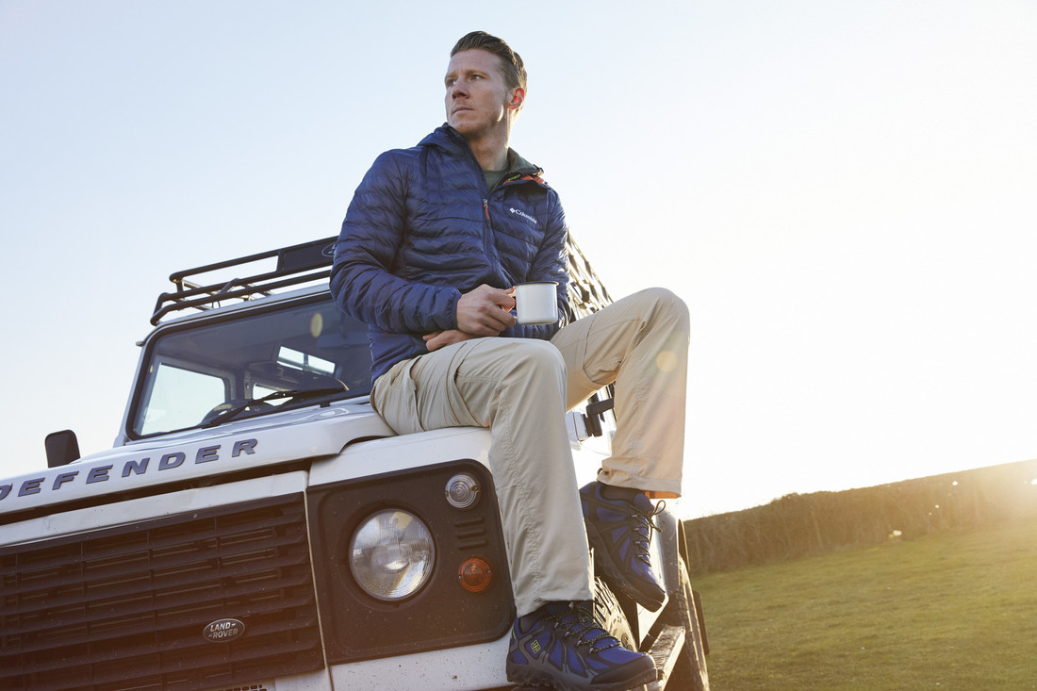

Slide 13
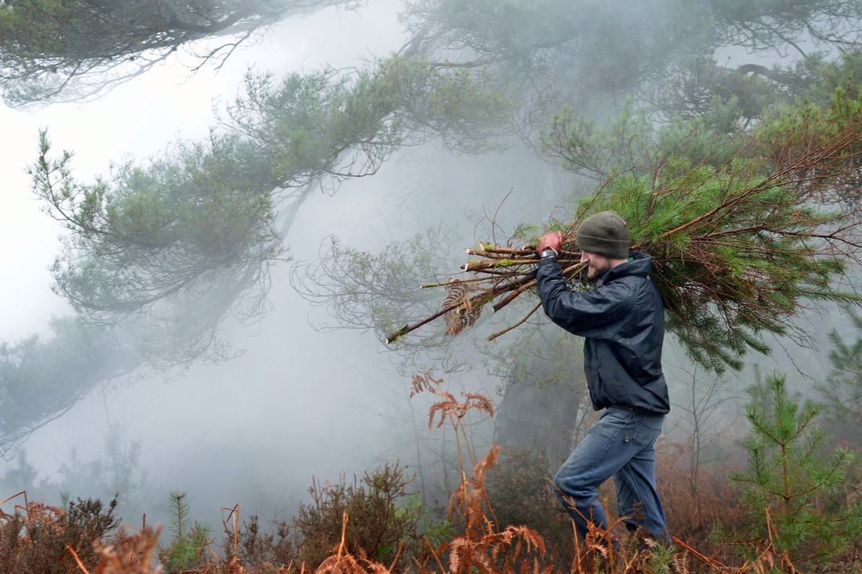
Ranger
Subject: | Science
Skills | People person Practical Ecology principles, Technical understanding
Career examples | Ranger Access officer Farming officer Foresters
Rangers
They complete the vital work on the ground across the park. From managing different habitats, to talking to different landowners to supporting people visiting the landscape. They are vital for the success of the national park.

