Slide 1
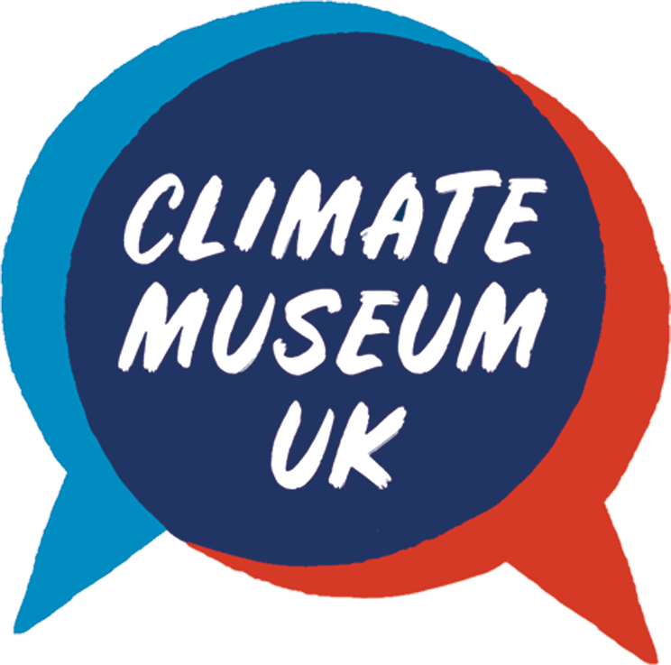
Welcome to Humanimals!
Created by Tanwen Morgan & Kevin Davidson of Climate Museum UK
Funded by South Downs National Park
Notes:
Welcome!
This lesson is going to look at the connection between humans and nature
We will focus on the play of words and the importance behind the meaning of words.

Slide 2
Nature?
Notes:
Teacher invites children to do a quick 3 minute drawing of “What do you imagine when you think nature?”
Option: Challenge children to do a ‘continuous drawing’ i.e. don’t take their pencil off the page.

Slide 3
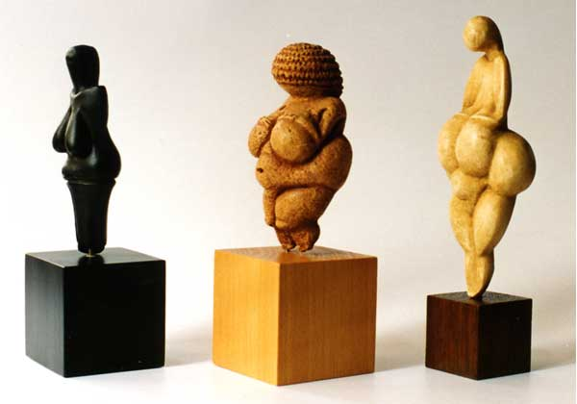
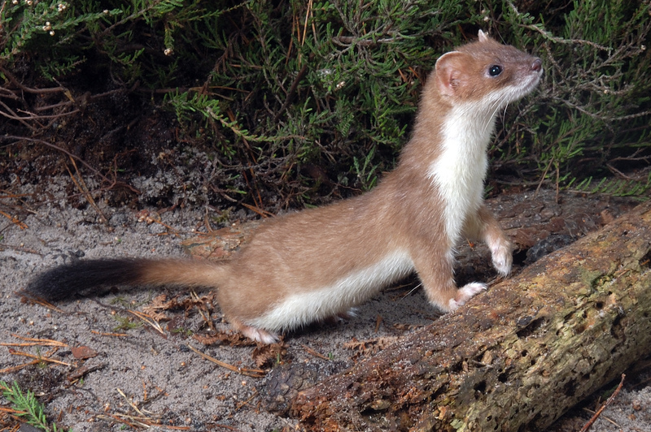
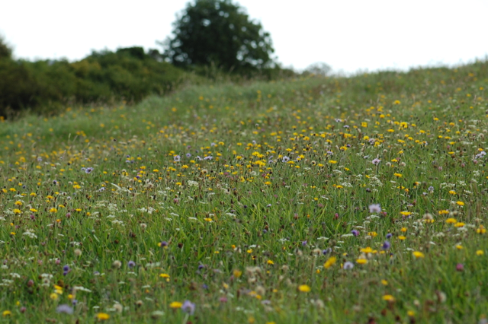
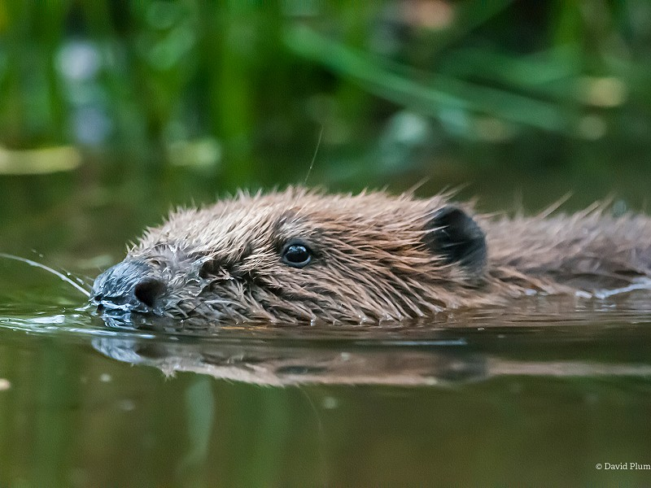
Humans are nature
We used to be more aware of this but today we see nature only as the images below
Notes:
If we think back to ancient cultures humans celebrated, respected and worshipped the earth
This happened universally across different countries and cultures e.g.
Gaia, the personification of earth in Greek mythology
Asase Afua, the goddess of lush earth in Akan culture
Mama Pacha, the goddess of earth in Incan culture
Or even split into multiples gods and goddesses reflecting different parts of the earth e.g. in Maori culture there is the god of earthquakes, volcanoes and seasons, Ruaumoko and earth mother, Papatuanuku (Papa)
Can you think of any others?
Additionally, before the Industrial Revolution, most people lived in rural areas and so were much more connected and in tune with nature. Observing it while being a part of it.

Slide 4
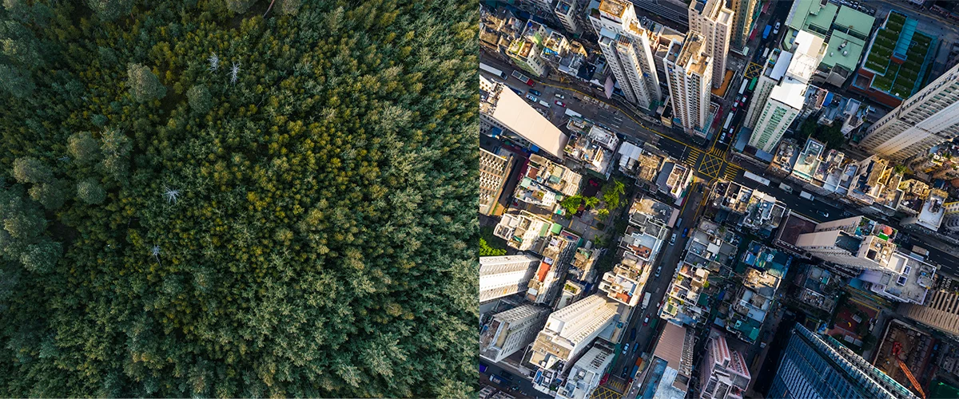
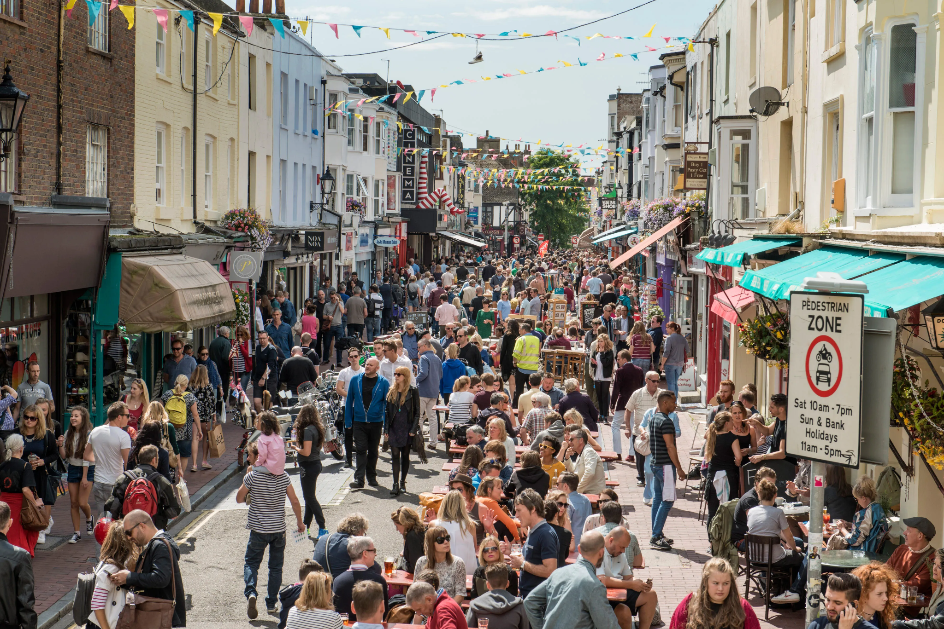
What happened?
Let’s go and visit nature
Notes:
Over the course of centuries human behaviours and beliefs changed
Humans moved away from nature and into cities
In part, this caused humans to see themself as separate from nature (hence ‘let’s go and visit nature’)
The more knowledge we’ve gained as a species, the more we believed we could control ‘nature’
We gained status from the things we bought, we spend our free time buying and spending and we’ve forgotten about our connection with the earth

Slide 5
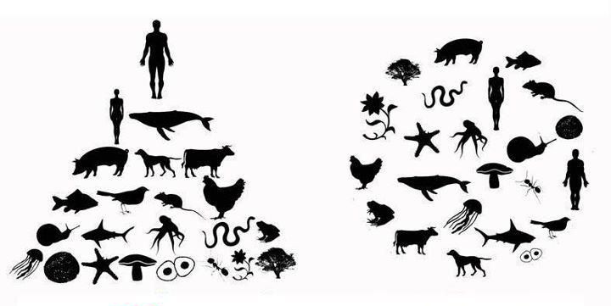
Notes:
First, let’s focus on image one (1) Has anyone heard of a food chain? (2) Can you define what a food chain is?
Although humans often end up at the top of the food chain, we wouldn’t exist without each plant, insect, bird, mammal, etc
Now let’s look at image two, how is it different? there is no obvious ‘leader’, we are one, all connected
Instead of seeing nature and food chains as a hierarchy we need to rethink how humans view nature, we are reliant on it for our existence, we are never separate from it

Slide 6
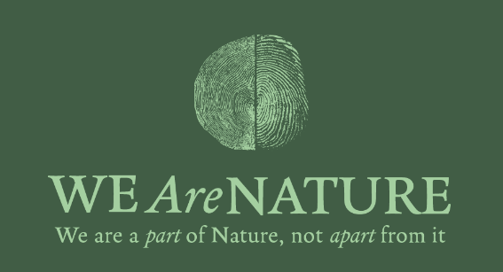
Notes:
Now we are going to look at a campaign by a group called Lawyers for Nature who worked alongside some designers from the House of Hackney to question whether we really are separate from nature
They believe that
We are connected to nature
We depend on nature
We are a small part of nature
Because of this, we need to look at the dictionary definition of nature and change it - you will see the definition in the clip on the next slide and then we’ll talk about it in more detail
But first, can anyone put their hand up and guess what is the definition?

Slide 7
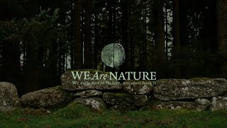
Notes:
Play this short clip to your class, it’s embedded in the slide but the link is here too: https://youtu.be/w7VpbqktqEw

Slide 8
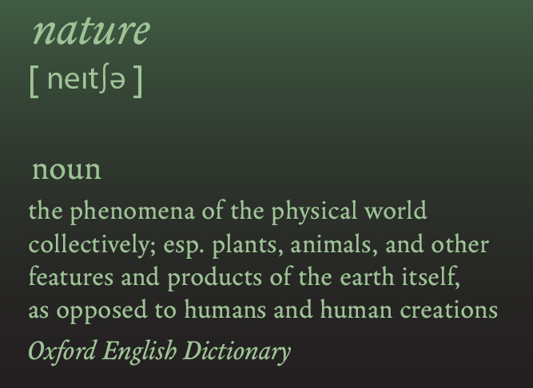
Notes:
The We Are Nature campaign believes that the Oxford Dictionary definition is harmful to how we view nature
Can anyone define ‘oppose’?
We are not opposed to nature, We Are Nature and we rely on nature to exist
It might seem a little pedantic or fussy to focus on the definition of one word, but words matter
We are going to do a mini thought exercise, you do not need to share any of your thoughts but I want you to think about some situations when words were powerful
Firstly, I want you to think of a time when words made you feel happy, connected or loved (stay silent for 10-20 seconds to allow them to think)
Now, I want you to think of a time when words made you feel sad, lonely or disconnected from someone (stay silent again)
Hopefully now you can see why words matter. The things we say and the words we choose hold power and impact our actions and behaviours
If we think we are opposed to nature we might believe that we can abuse it or take advantage of it, but when we see that We Are Nature, we will be more likely to treat it with love and respect
The importance of words can also be seen in the slogan used by We Are Nature, how does it play on words?

Slide 9
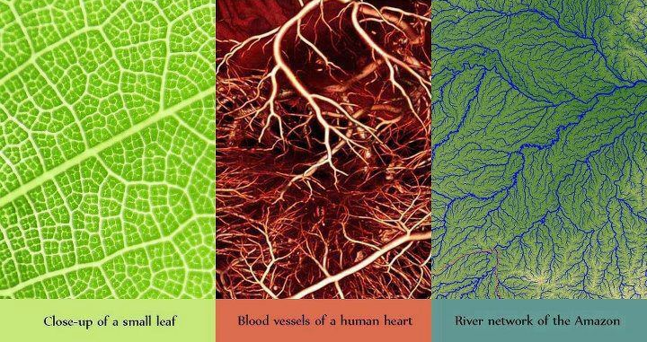
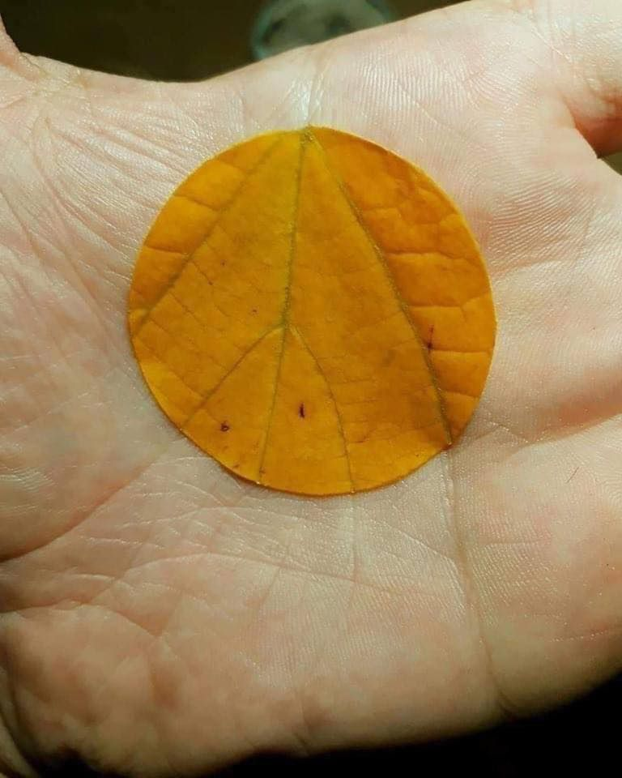
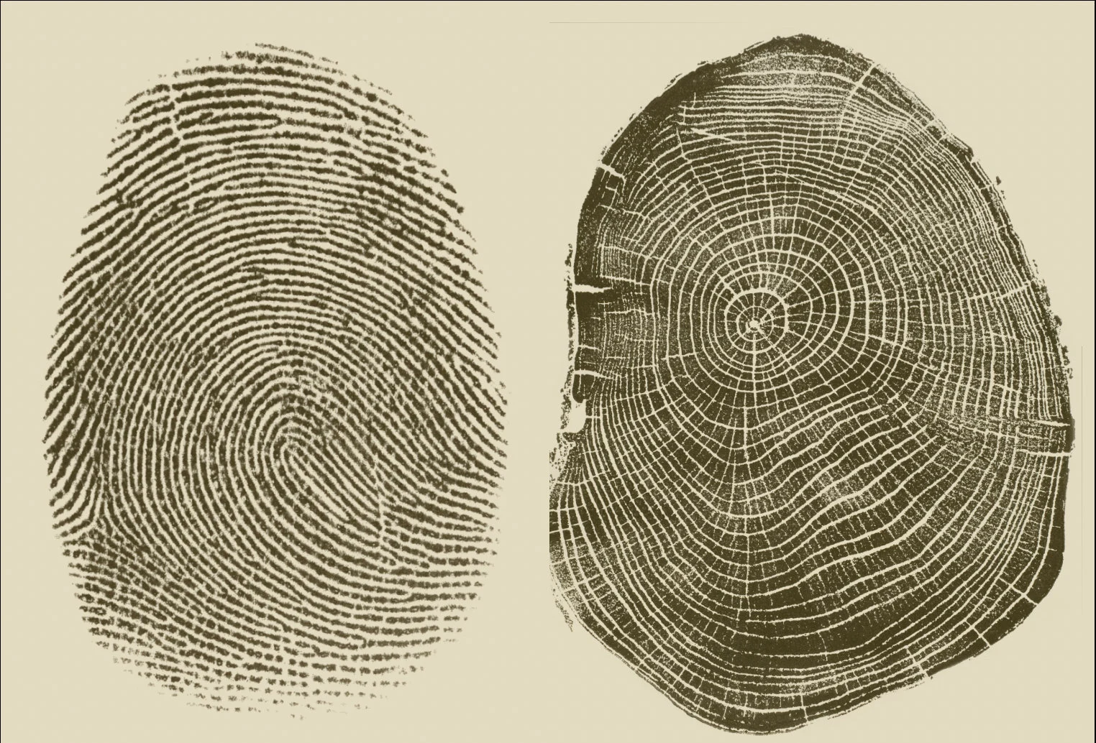
Notes:
Let’s delve in and look at some examples of similarities between humans and nature
Picture 1: here you can see how the lines on our palms mirror the lines on a leaf
Picture 2: please could someone read out the labels for each image? Now you can again, the similarities between plants, humans and the earth
Picture 3: what do you think these are? A human fingerprint (which remember each of us have a different fingerprint!) and the rings of a tree which reflects the age of the tree. A tree gains a new ring for each season it lives through

Slide 10
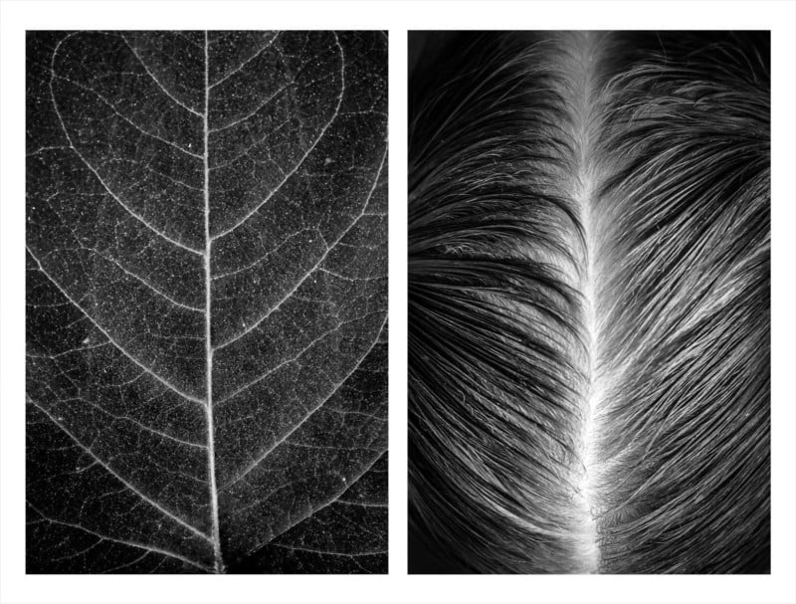
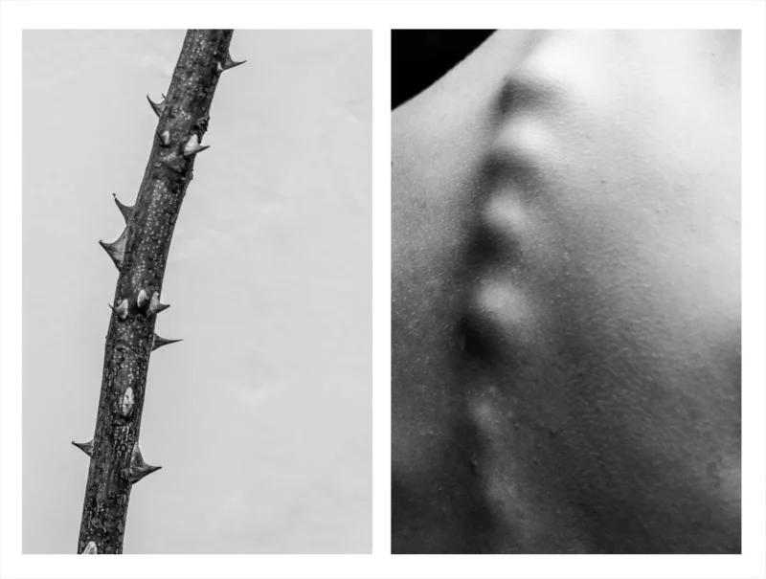
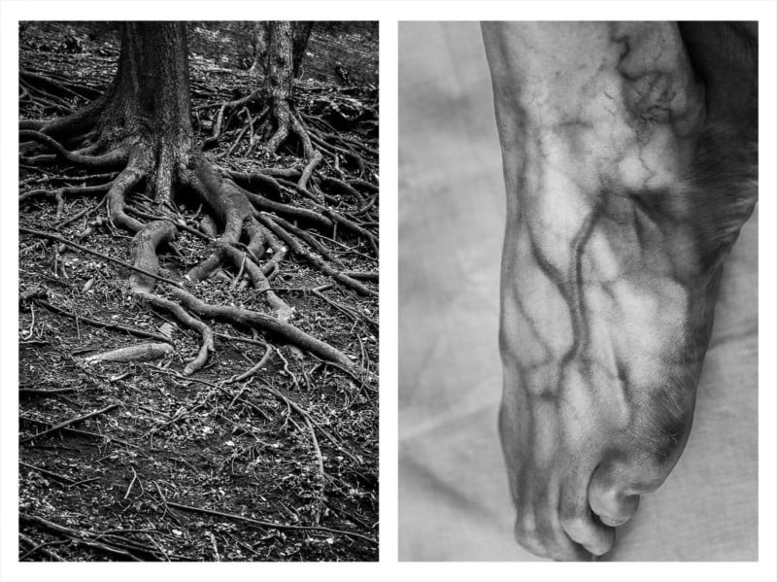
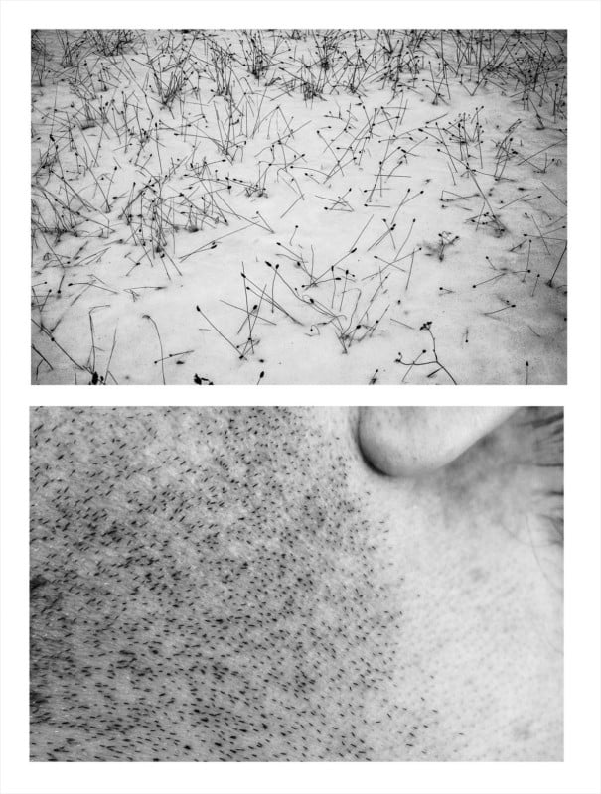
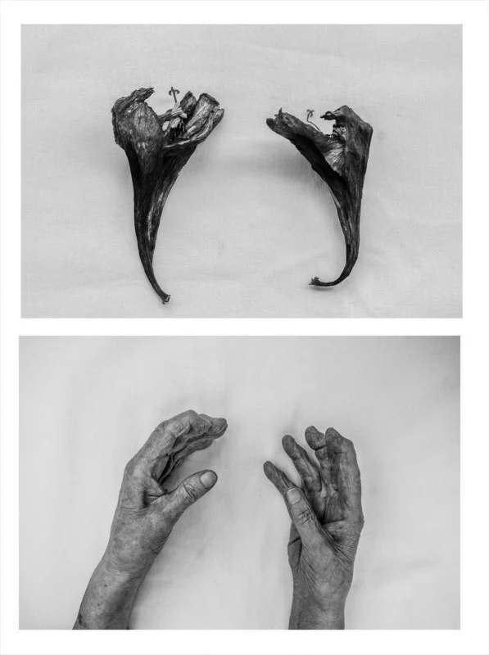
Alicja Brodowicz (@alicjabrodowicz)
Notes:
https://petapixel.com/2018/07/18/photos-that-show-similarities-between-the-human-body-and-nature/
This artist, Alicja, can also see the crossovers between humans and nature and decided to take photographs to show this
Ask students to discuss in pairs what you can see in each image and feedback as a class
Answers (top line left to right)
Picture 1: a leaf and a hair line
Picture 2: a thorn and a spine
Picture 3: roots of a tree and veins
Picture 4: grass growth in a dune and stubble
Picture 5: flowers and hands

Slide 11
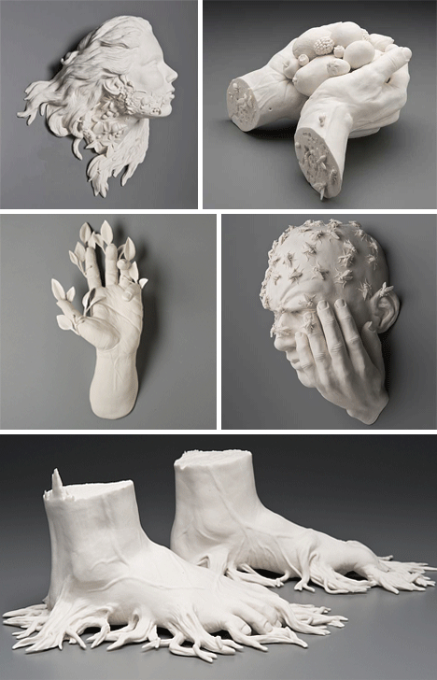
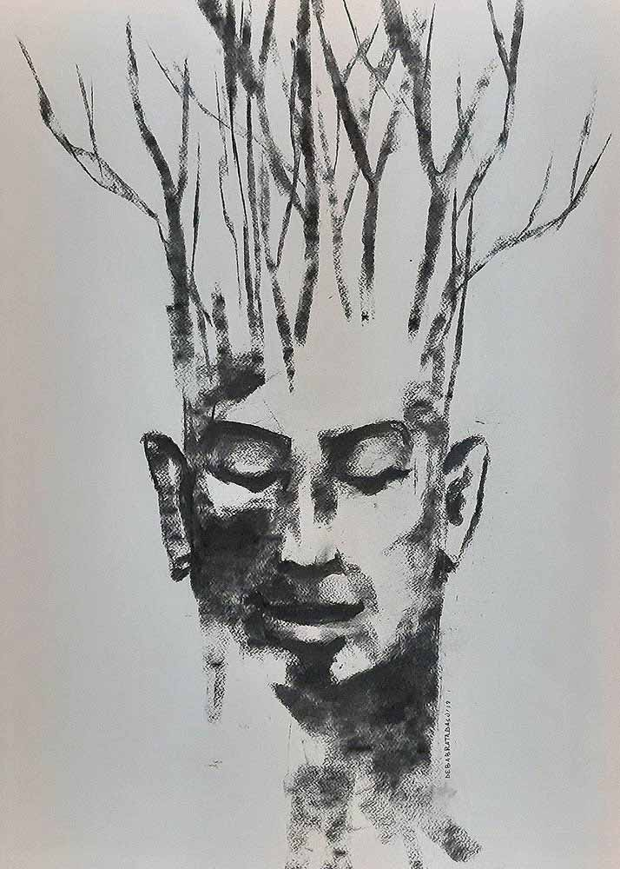
Notes:
Nature is the inspiration behind many artists’ work
Sometimes art is literal and other times it can be mythical or whimsical

Slide 12
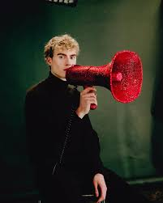
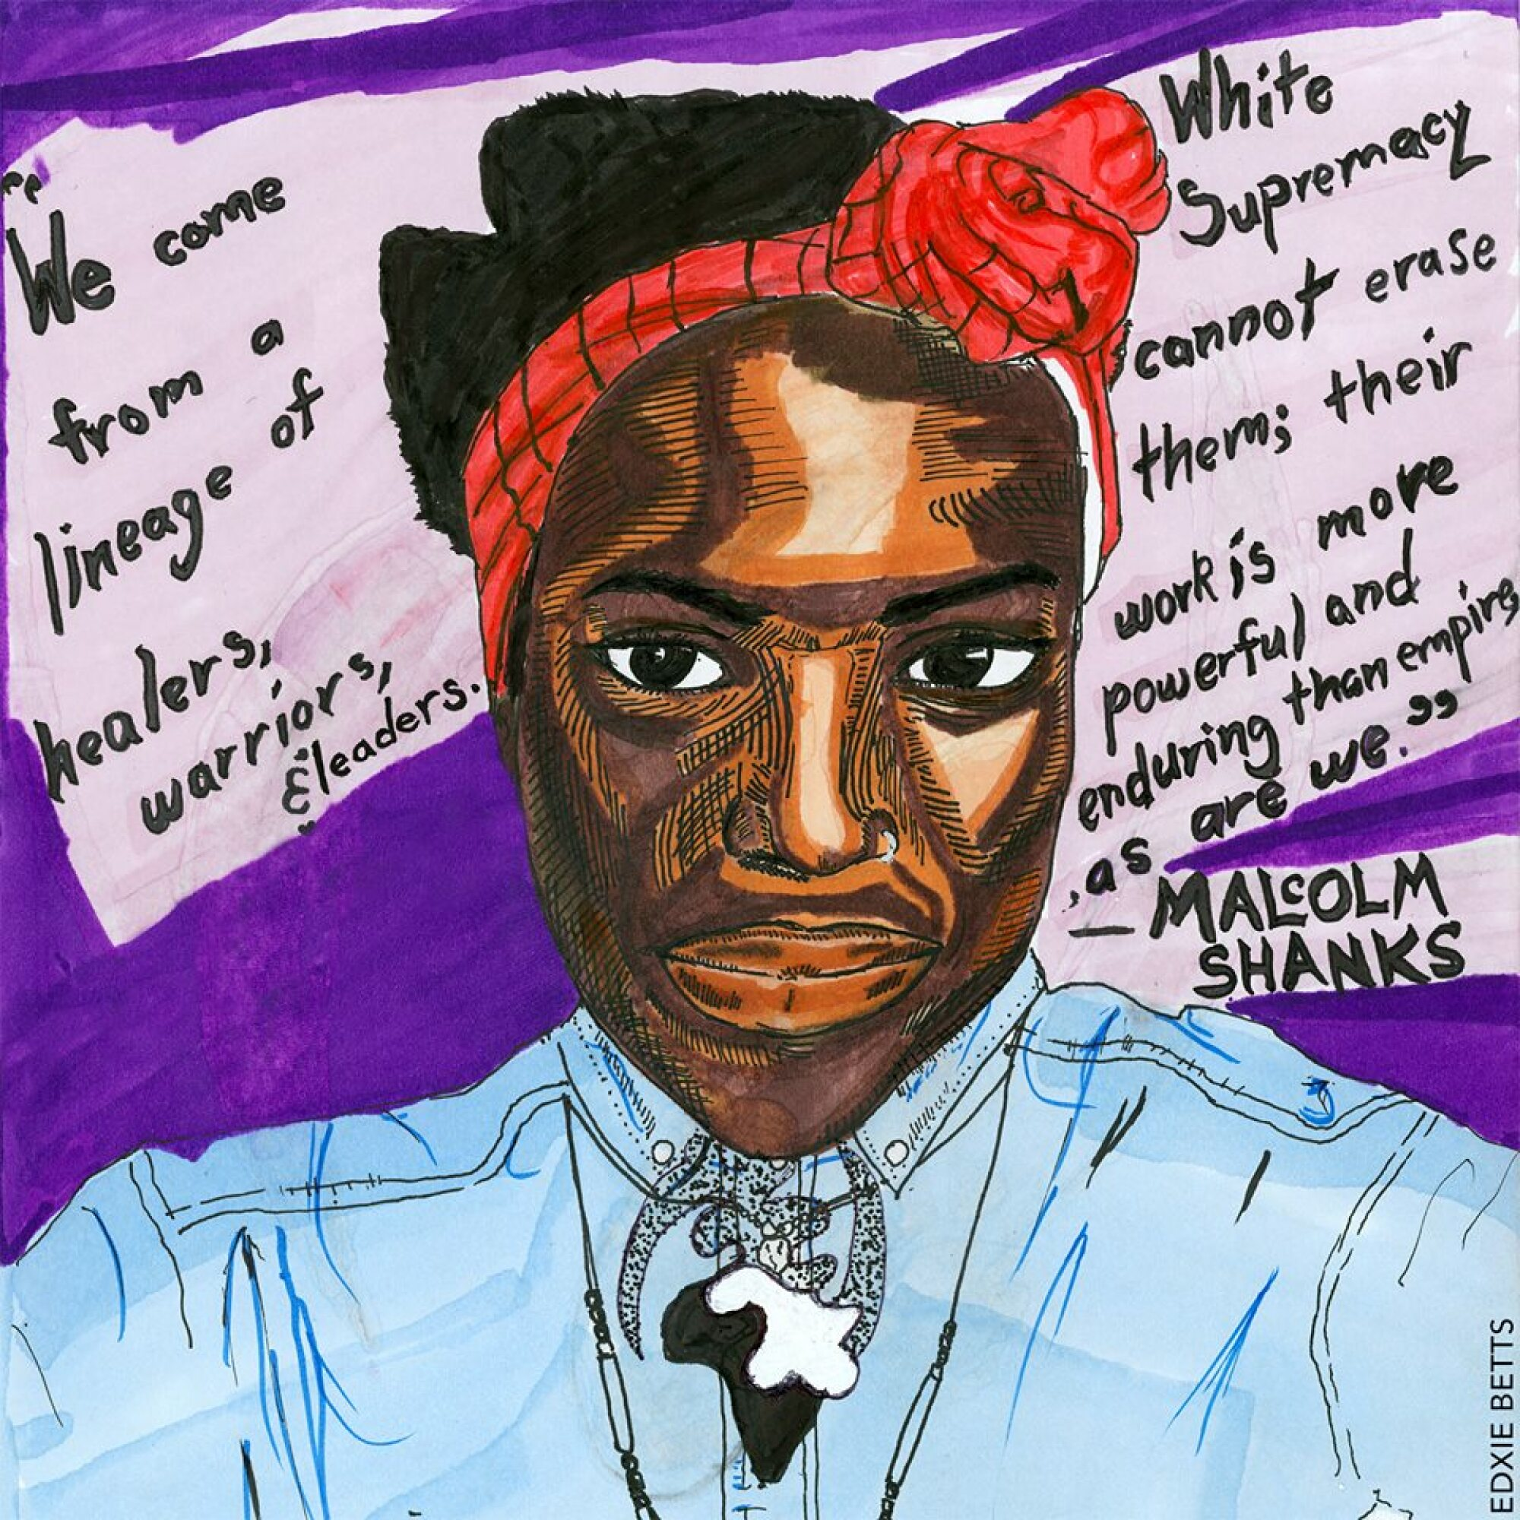
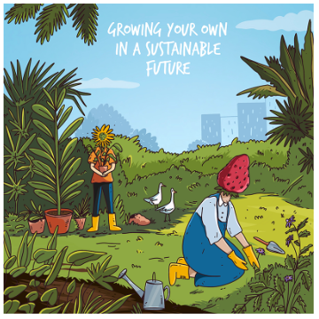
When does art becomes activism?
Elijah McKenzie Jackson
Edxie Betts
Preethika Asokan
Notes:
Art has the power to change how we view things, especially if the topic is a tricky one to discuss
Above are some examples of artists using their voices for important messages
Elijah McKenzie Jackson has made a megaphone out of red jewels to represent the red shoes in the Wizard of Oz and the famous phrase ‘there’s no place like home’ - his piece shows us that we need to use our voices to stand up for our planet and home
Edxie Betts is a black trans artist who uses her art to support people who are treated unfairly in society
Preethika Asokan is an artist from Bangalore who uses her voice to reframe how people and planet can work together rather than be opposed to one another

Slide 13
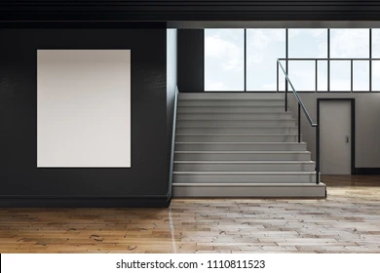
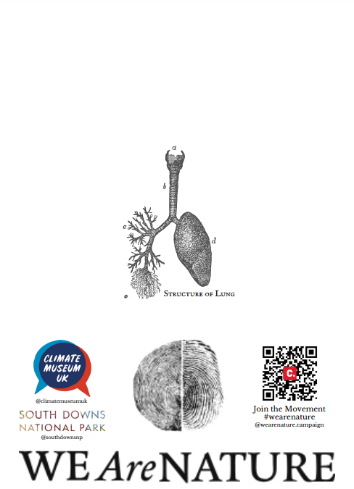
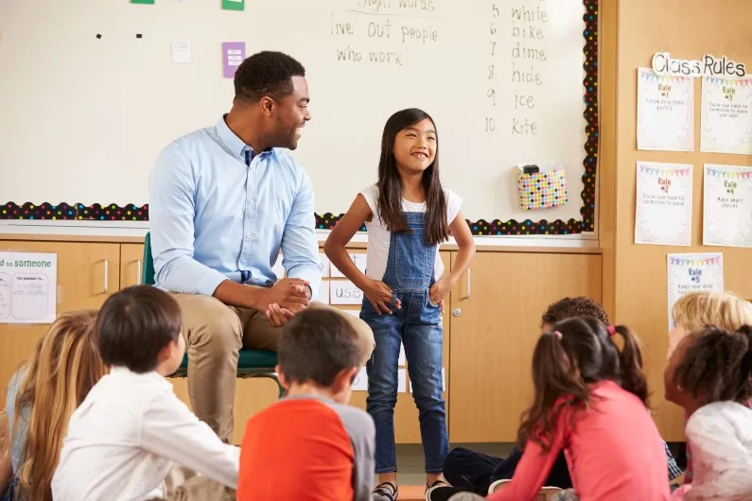
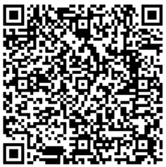
Becoming an ARTIVIST
1.
2.
3.
Sign the petition to change the definition of Nature in the Oxford Dictionary
Become the teacher and teach someone else!
Put your poster up to spread the message
Notes:
Now it’s your turn
Let’s play on words again, you are going to be an artist AND and an activist, an artivist!
You will use your art to spread the important message that We Are Nature, we are not apart from it
First of all, does anyone know what a petition is?
If you want to get the Oxford Dictionary definition of nature changed, here is your chance to sign a petition. Any age can sign it as long as you have an email address and want to. You can use the QR code on this slide, or this link https://www.change.org/p/change-uk-dictionary-definitions-of-the-word-nature-to-include-humans?ref=lawyersfornature.com you will also be able to find a QR code on your poster which we’ll give out soon
Secondly, once you have finished your art, we want you to put your poster up; in school, in your window at home, you could even ask your local newsagents to put it up too
Lastly, we’ve shared the message with you, but your job is to teach someone else. You can download your own posters and do them at home or take them to an after school club, share the message that We Are Nature

Slide 14
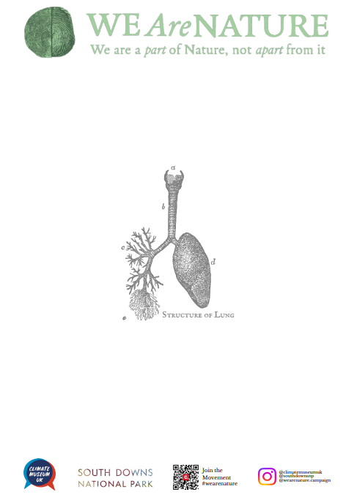
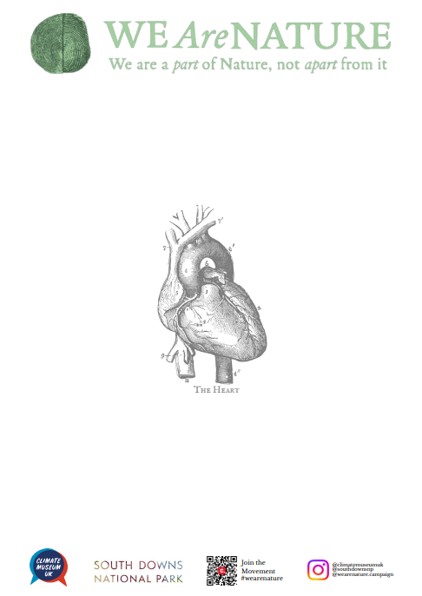
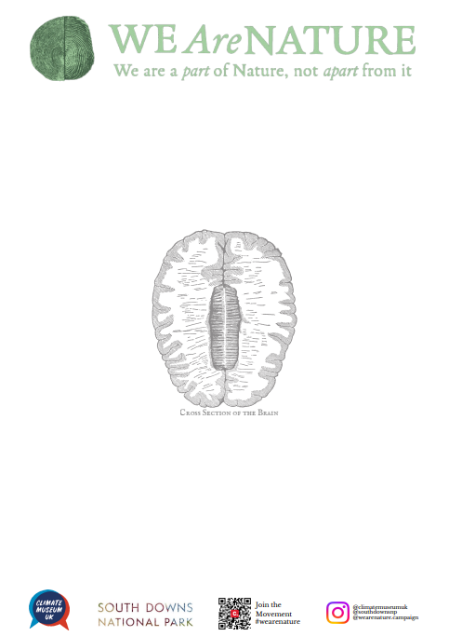
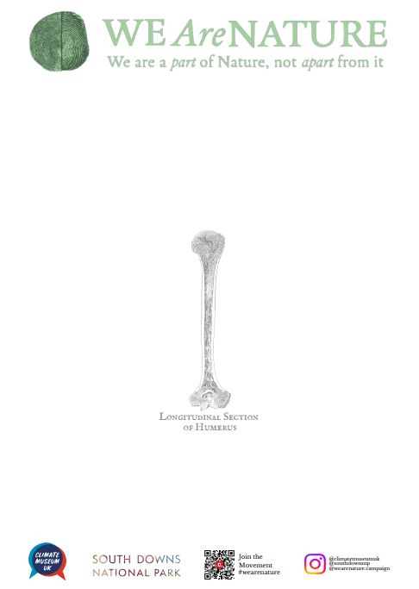
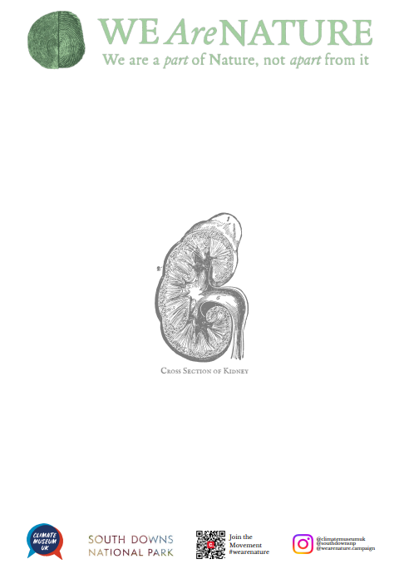
Becoming an ARTIVIST
Lungs
Heart
Brain
Bone
Kidney
Notes:
We are now going to get the chance to become an artivist, here are some of the posters you can choose from
It’s up to you what you turn these organs into, perhaps you see a forest or an animal, maybe you can see a creature or plant underwater when looking at these organs
It’s all about seeing the links between humans and nature
Think outside the box and fill as much of the page as you can with colour

Slide 15
Let’s listen to nature
https://soundcloud.com/phil-mill1/sets/colchester-sound-recordings?utm_source=clipboard&utm_medium=text&utm_campaign=social_sharing
Notes:
(This links you to a playlist of sounds in nature (including humans in a park!) which the students can listen to while they draw their posters)

Slide 16
Made by: Nature and …
(You, the plant fibres in the paper and the wood in the pencils)
Notes:
Now that we’re done, it’s time to think about the connection between humans and nature again
The paper you have used is made from trees and plant fibres, while the pencils you have used are also made from wood, though remember that you too, are nature
It’s time to sign your image, please write Made by Nature and… (include your name)

Slide 17
From ARTIVIST …to teacher
1.
Put your poster up and spread the message
2.
Remember…
3.
Consider who you could teach this lesson to. Is there another class? Do you attend a youth club? Could you teach your family or friends?
With thanks from
and
Notes:
Thanks for taking part in our lesson
These are your next steps:
(1) please put your poster up somewhere visible so that others can learn about the We Are Nature campaign and rethink about the dictionary definition of nature
(2) remember that We Are Nature, next time you’re outside what similarities can you see between humans and nature or look for things in nature that make you feel happy / amazed / in awe
(3) consider whether you could become the teacher. Spread the message even further and download your own versions of the We Are Nature posters and take them along to your own class

